Slide 1
Learning Objective
3-2 We will evaluate¹ equations and inequalities.
¹ to judge
What are we going to do today?
What are we going to evaluate?
What does evaluate mean?
We will evaluate equations and inequalities.
We will evaluate equations and inequalities.
Evaluate means to judge.
Activating Prior Knowledge
Teacher: 9+1 12+3 5-1 14-4
Student : 3+2 9-4 8-7 16-5
1. Circle the greatest value .
2. Circle the value that is the least.
3. Circle the values that are equal.
10
15
4
10
5
5
1
11
Teacher works problem #1 then students identify their answer on their whiteboards (CFU). Teacher works problem #2 then students identify their answer on their whiteboards (CFU). Teacher works problem #3 then students identify their answer on their whiteboards (CFU).
CFU: Today, we will evaluate equations and inequalities, which will require us to use skills we already know such as how to add, subtract, and compare values.

Slide 2
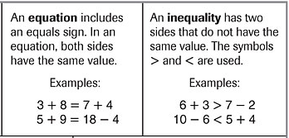
3-2 We will evaluate equations and inequalities.
Concept development
11
11
9
5
What is an equation?
An equation has an equal sign and both sides have the same value.
Which example is an inequality? How do you know?
A. 4 – 1 < 2 + 5
B. 8 + 3 = 15 - 4
A
the two sides do not
Example ___ is an inequality, because _________________
______________________________________.
have the same value and the < symbol is used

Slide 3
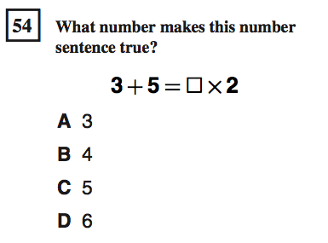
3-2 We will evaluate equations and inequalities.
Importance
CST or Test
Playing sports
If you want to get better at something, then you have to compare how you practice to how your competitor practices.
3
>
2 hours + hours < 4 hours
you
competitor
Buying gifts (Being fair)
Your mom can determine how many toys to buy for each of the children so they all have the same amount of toys.
3 marbles + 2 marbles = 4 marbles + marbles
1
Why is it important to evaluate equations and inequalities? (pair-share) Does anyone else have another reason why it is important to be able to evaluate equations and inequalities? You may give me one of my reasons or one of your own. Which reason means more to you? Why?

Slide 4
3-2 We will evaluate equations and inequalities.
Skill development/Guided practice
Write >, <, or = in the . Tell if the number sentence is an equation or an inequality.
2. 12 – 10 2
1. 12 + 10 22
=
=
22
2
equation
equation
>
4. 37 – 24 79 - 28
3. 52 + 23 65 - 14
<
75
51
13
51
inequality
inequality
>
5. 25 + 44 52 - 20
=
6. 38 – 12 14 + 12
69
32
26
26
inequality
equation
Step 1
Step 2
Calculate the value of each expression, if necessary.
Compare the values. Make sure the number sentence is true.
Skill development CFU: How did I calculate the value of each expression? What values did I have to compare? What symbol did I write to make the number sentence true? How did I determine if the number sentence is true? How did I decide it was an equation/inequality?
Guided practice CFU: Do step #1 and show me. (Randomly choose students to share answers.) Do step #2 and show me. Why did you choose the “=, <, or >” symbol? How did you decide it was an equation/inequality?

Slide 5
3-2 We will evaluate equations and inequalities.
Skill development/Guided practice
Write a number in the that makes the number sentence true.
9
1. 12 + = 20
2. - 4 = 5
8
3. 123 + 52 < 199 -
14
27
4. 287 – 33 > + 222
26 32 14
36 27 41
111
5. + 140 = 498 - 247
6. 97 - = 31 + 23
43
111 47 152
34 63 43
Step 1
Step 2
Calculate the value of each expression, if necessary.
Compare the values. Make sure the number sentence is true.
Skill development CFU: How did I calculate the value of each expression? As I compare the values, what do I need to make sure is true? Why did I choose the number #? How did I determine the equation/inequality is true?
Guided practice CFU: Do step #1 and show me. (Randomly choose students to share answers.) Do step #2 and show me. Why did you choose that number? How do you know the equation/inequality is true?

Slide 6
3-2 We will evaluate equations and inequalities.
Closure
Write the word next to its definition.
equation inequality
________. I have one of these symbols > or < and my two sides are not equal.
________. I have an equal sign and my two sides have the same value.
inequality
equation
Write >, <, or = in the . Tell if the number sentence is an equation or an inequality.
>
inequality
2. 46 + 51 22 + 67
Write a number in the that makes the number sentence true.
3. 78 – 24 > 31 +
14
23 14 56
4. What did you learn today about equations and inequalities? Why is that important to you?
CFU: For #1 have students write the word (answer) on their whiteboards.

Slide 7
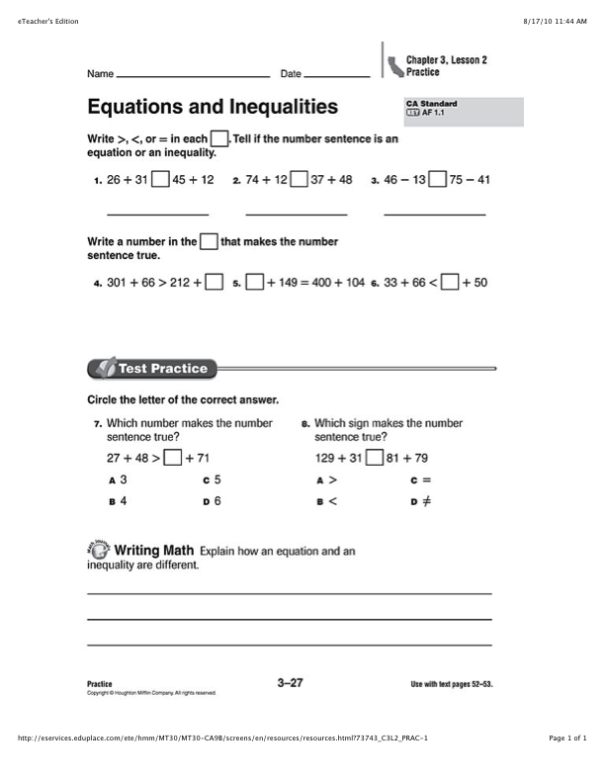
Independent Practice
300 120 214 350 445 355 17 47 87

