Slide 1
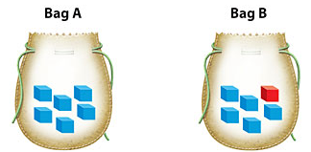
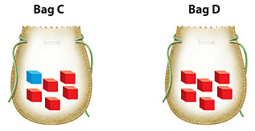
Learning Objective
23-2 We will identify¹ the probability of an event happening.
¹ to describe
What are we going to do today?
What are we going to identify?
What does identify mean?
We will identify the probability of an event happening.
We will identify the probability of an event happening.
Identify means to describe.
Activating Prior Knowledge
Bag A
If I wanted a blue cube, what bag would I want to pick from?
If you wanted a red cube, what bag would you want to pick from?
Bag D
Teacher works problem #1. Then students identify their answer on their whiteboards (CFU).
LO connection: Today, we will identify the probability of an event actually happening, which will require us to look and describe how much we think something will occur.

Slide 2

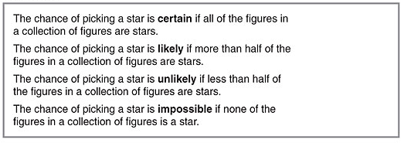
23-2 We will identify the probability of an event happening.
Concept development
What does probability describe?
Probability describes __________________________________
the chance that an event will happen.
Which box will give you a likely chance of picking a heart? How do you know?
A
more than half of the
I am more likely to pick a heart from box ___, because _________________
________________.
shapes are hearts
A
B

Slide 3
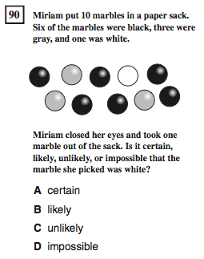
23-2 We will identify the probability of an event happening.
Importance
CST or Test
Lottery
If you play the lottery, you need to know the probability of winning so you aren’t disappointed if you lose. More than likely you will lose. Pretty much impossible.
Weatherman
A weatherman analyzes the probability of it raining, so he/she can deliver the weather accurately.
Why is it important to identify the probability of an event happening? (pair-share) Does anyone else have another reason why it is important to be able to identify the probability of an event happening? You may give me one of my reasons or one of your own. Which reason means more to you? Why?

Slide 4
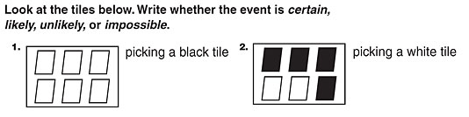

23-2 We will identify the probability of an event happening.
Skill development/Guided practice
Impossible
Unlikely
Likely
Certain
Certain = For sure
Likely = Almost sure, more than ½
Unlikely = Probably not, less than ½
Impossible = No way!
Skill development CFU: Do #1. How did I identify the probability as impossible? Do #2. How did I identify the probability as unlikely?
Guided practice CFU: Do #3 and show me. (Whiteboard - Randomly choose students to share answers.) Why did you identify the probability as certain? Do #4 and show me. Why did you identify the probability as likely?

Slide 5
23-2 We will identify the probability of an event happening.
Skill development/Guided practice
Is the event certain, likely, unlikely, or impossible?
Certain
We are at school right now. _________________
Everyone brushed their teeth this morning. __________________
We are all girls. ____________________
We are all wearing white socks. ______________________
Mrs. _______ will win the lottery. ___________________
Mrs. _____ will lose her shoes. ______________________
Certain or likely
Likely or unlikely
Likely or unlikely
Impossible
Impossible or unlikely
Certain = For sure
Likely = Almost sure, more than ½
Unlikely = Probably not, less than ½
Impossible = No way!
Skill development CFU: Do #1. How did I identify the probability as certain? Do #3. How did I identify the probability as ____________? Do #5. How did I identify the probability as impossible?
Guided practice CFU: Do #2 and show me. (Whiteboard - Randomly choose students to share answers.) Why did you identify the probability as _______? Do #4 and show me. Why did you identify the probability as ________? Do #6 and show me. Why did you identify the probability as ______________?

Slide 6

23-2 We will identify the probability of an event happening.
Closure
What describes the chance that an event will happen?
A. Certain B. Unlikely C. Probability
Describe the probability as impossible, unlikely, likely, or certain.
2.
Unlikely
Certain = For sure
Likely = Almost sure, more than ½
Unlikely = Probably not, less than ½
Impossible = No way!
_________________
Of picking a white circle
Certain
3. This week will have a Friday. ________________
4. What did you learn today about identifying the probability of an event happening? Why is that important to you?
CFU: For #1, #2, and #3 have students write the answer on their whiteboards.

Slide 7
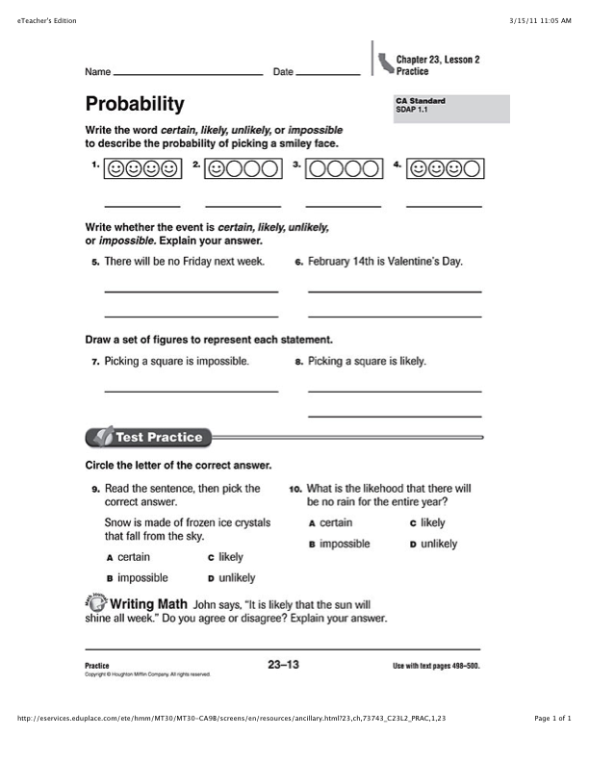
Independent
Practice
Skip #7, 8, & Writing Math

