Slide 1
Learning Objective
We will identify¹ if a shape has a line of symmetry.
¹to find
What are we going to do today?
What are we going to identify?
What does identify mean?
We will identify if a shape has a line symmetry.
We will identify if a shape has a line symmetry
Identity means to find.
Activating Prior Knowledge
Teacher: Will fold a rectangle into half.
Student: Will fold and cut out a Heart.
When I folded the figure I got matching parts. When you folded your figure did you get matching parts? Check with your partner. How does it look?
LO Connection: Today, we will indentify if a shape has a line of symmetry, which will require us to fold shapes in half to find matching parts.

Slide 2
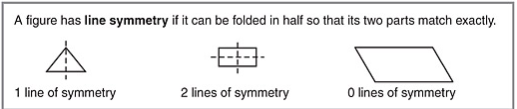


MG 3.4 We will identify¹ if a shape has a line of symmetry.
Concept development
A.
When does a figure have a line of symmetry?
When it can be folded in half so that it has two equal parts.
B.
Which figure has a line of symmetry? How do you know?
A
it can be folded in half
Example ___ is a line of symmetry, because _________________
______________________________________.
so that it has two matching parts.

Slide 3
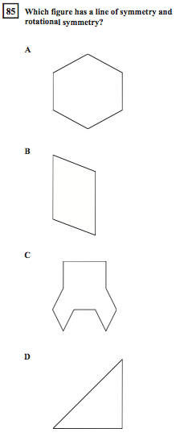

MG 3.4 We will identify¹ if a shape has a line of symmetry
Importance
CST or Test
Artist
If you were an artist you would need to understand symmetry if you were drawing an apple or a human face.
Architect
When a bridge needs to be symmetrical to hold up the load.
Why is it important to indentify the line of symmetry? (pair-share) Does anyone else have another reason why it is important to be able indentify the line of symmetry? You may give me one of my reasons or one of your own. Which reason means more to you? Why?

Slide 4
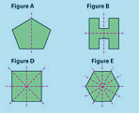

MG 3.4 We will identify¹ if a shape has a line of symmetry
Skill development/Guided practice
Students open your books to page 581.
Teacher: A, E
Together: B, D
Students: C
Step 1
Step 2
Look at the shape and identify if the shape has equal parts.
Identify how many lines of symmetry the shape has.
Skill development CFU: How did I know that Figure A had one line of symmetry? How did I determine Figure E had 6 lines of symmetry?
Guided practice CFU: Do step #1, and tell your partner if the shape has equal parts.
Do step #2 and show me on your white board how many lines of symmetry there are. How do you know? (Pair Share)
Notes:
Teacher will trace and fold while thinking aloud. Fold different so it works and does not work.
Look at PINK lines- mean folds.

Slide 5
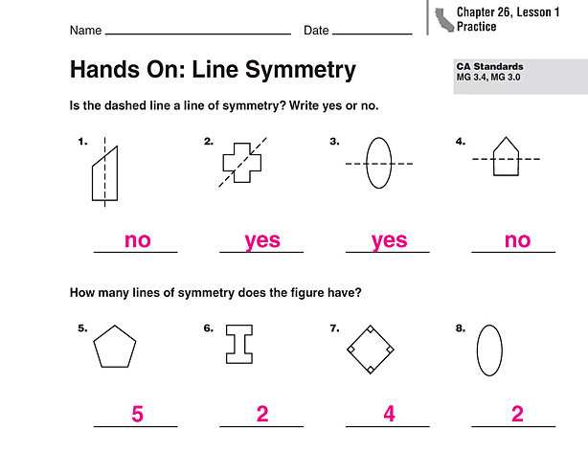
MG 3.4 We will identify if a shape has a line of symmetry
Skill development/Guided practice
Teacher: 1, 5
Together: 2, 6
Students: 3,4,7,8
Step 1
Step 2
Look at the shape and identify if the shape has equal parts.
Identify how many lines of symmetry the shape has.
Skill development CFU: How did I know that the dashed line on #1 was not a line of symmetry? How did I determine the number of lines of symmetry that #5 has?
Guided practice CFU: How did you know the dash line on #2 was a line of symmetry?
How did I determine the number of lines of symmetry that #6 has?

Slide 6


MG 3.4 We will identify if a shape has a line of symmetry
Closure
How do you know when a shape has a line of symmetry?
When it can be folded in half so that it has two equal parts.
Is the dashed line a line of symmetry?
On your White Board Write
YES or NO
How many lines of symmetry does the shape have?
On your White Board Write
A . 1 or B. 3
What did you learn today about Symmetry and lines of Symmetry?
Why is that important to you? Pair-share
Notes:
Before you do 3,4,7,8 Please close your books. For Closure NO pair share!

Slide 7
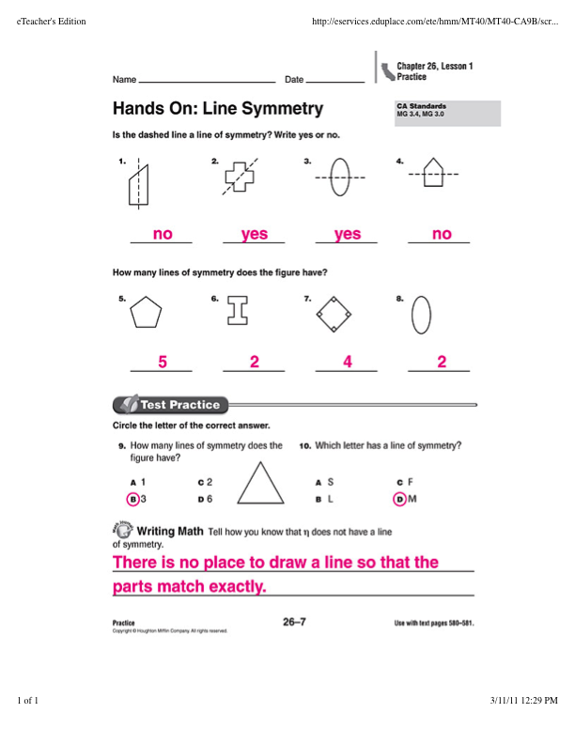
Idependent
Practice

