Slide 1
Learning Objective
4-1 We will make predictions.
What are we going to do today?
What are we going to make?
What are we going to do with predictions?
We will make predictions.
We will make predictions.
We will make predictions.
Activating Prior Knowledge
Match the clue with the action.
1. The man is angry. cry
2. The girl is hungry. yell
3. The child is sad. laugh
4. The person heard a funny joke. eat
Teacher works problem #1 then students solve problem #2 on their whiteboards (CFU). Teacher works problem #3 then students solve problem #4 on their whiteboards (CFU)
CFU: Today, we will make predictions, which will require us to read clues and remember our own experiences.

Slide 2
4-1 We will make predictions.
Concept Development
A prediction is what you think may happen next.
  clues from story & own experience prediction
Example:
1. Josh woke up early on Saturday morning and looked outside the window. 2. The sun was out and it was hot. 3. His dad called to Josh and said, “It is a perfect day, don’t forget to bring a towel!” 4. Josh grabbed a towel and they left the house.
Example of an prediction: Josh and his dad are going to the beach.
Non-example: Josh will eat breakfast.
CFU
What is a prediction? A prediction is _________________________________________
what you think may happen next.
clues from a story and your own experiences.
What do you use to make a prediction? You use ___________________________________
What is the difference between the example and the non-example?
The difference is _________________________________________________
the example uses clues from the story and the non-example doesn’t make sense based on the clues.
Which statement below is another possible prediction? Why?
A. Josh and his dad will go to the zoo.
B. Josh and his dad will go to a water park.

Slide 3
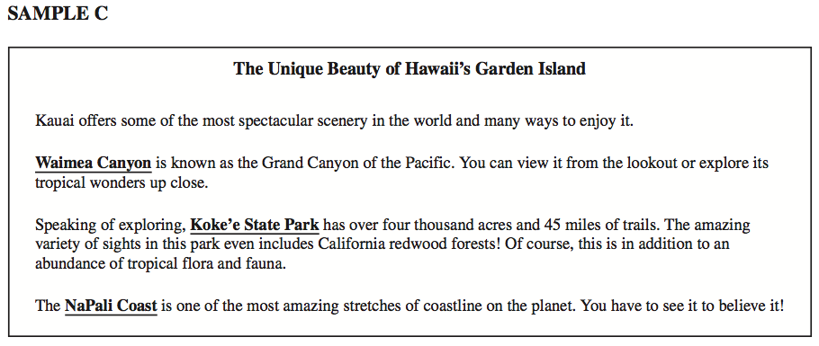
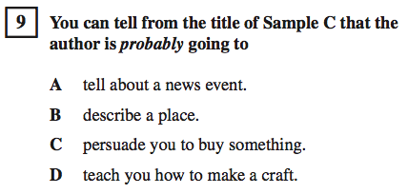
4-1 We will make predictions.
Importance
CST or Test
Reading
Predictions help you become a better reader.
For example, you can figure out what will happen next.
Making plans
Predictions help people make plans for the future.
For example, your mom predicts she will have to go to the grocery store soon when there is not much food in the refrigerator.
Why is it important to make predictions? (pair-share) Does anyone else have another reason why it is important to be able to make predictions? You may give me one of my reasons or one of your own. Which reason means more to you? Why?

Slide 4
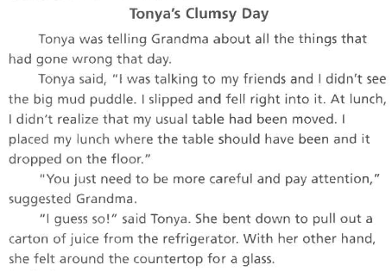
4-1 We will make predictions.
Skill development/Guided practice
A prediction is what you think may happen next.
Prediction
Tonya will knock over the glass and it will break.
Supporting details
Things have been going wrong for Tonya all day. Tonya is not being careful and paying attention like her grandma told her to do, so Tonya will knock over the glass.
Step 1
Step 2
Step 3 | Write your supporting evidence.
Read the story and underline details that will help you make a prediction.
Write a prediction.
Skill development CFU: How did I know what details to underline? How did I make my prediction?

Slide 5
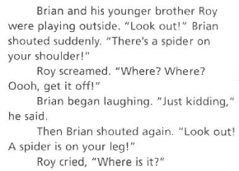

4-1 We will make predictions.
Skill development/Guided practice
A prediction is what you think may happen next.
Prediction
Roy is not going to believe Brian. Roy is going to get scared, because the spider might get on him. (Another joke)
Supporting details
Brian has been teasing Roy by tricking him into believing there is a spider on him when there really is no spider. Roy will not believe Brian when Brian is actually telling the truth, because of all the times he tricked him earlier in the day.
Step 1
Step 2
Step 3 | Write your supporting evidence.
Read the story and underline details that will help you make a prediction.
Write a prediction.
Guided practice CFU: What were the boys doing? What did Brian shout? What is on his shoulder? How did you know what details to underline? What is your prediction? Why did you make that prediction?

Slide 6
4-1 We will make predictions.
Closure
What do you call something you think may happen next based on clues from the story and your own experiences?
A prediction is something you think may happen next based on clues from the story and your own experiences.
2.
Maya and Gwen are best friends. When they spend time together they always have fun. The last time Maya slept over Gwen’s house, they stayed up late giggling and telling stories. They played games and watched a funny movie. They even let Gwen’s younger brother Nate join in while they played computer games. Tonight Maya is going to sleep over Gwen’s house again.
Prediction
Maya and Gwen will have fun.
Supporting details
Maya and Gwen are best friends. They had fun during the last sleep over.
Read the story and underline details that will help you make a prediction.
Step 1
Step 2
Step 3 | Write your supporting evidence.
Write a prediction.
3. What is something you learned today about making predictions? Why is that important to you?
CFU: For #1 have students write the word (answer) on their whiteboards. For #2 choral read and then have students underline key words (handout provided for whiteboards) and then write prediction and details on whiteboards.

Slide 7
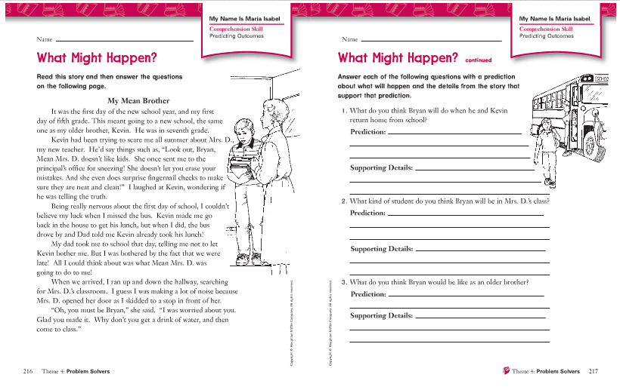
Independent Practice

