Slide 1
One Land, Many Trails
I have heard of a land
Where the earth is red with promises…
Where the imagination has no fences
Where what is dreamed one night
Is accomplished the next day
Joyce Carol Thomas
from “I Have Heard of a Land”

Slide 2
One Land, Many Trails
What do you think the author means when she says “the earth is red with promises”?
What challenges do you think might have faced the people who lived here long ago?
What do you think is the meaning of the title of this theme, One Land, Many Trails?
Recall what you know about the American frontier long ago. Describe the different kind of people who lived and worked there.

Slide 3
Author: Joseph Bruchac Illustrator: Rocco Baviera Genre: biography ~ the true story of how Sitting Bull earns his name
Day 1
Day 2
Day 3
Day 4
Day 5

Slide 4
Day 1 Schedule
Reading
Vocabulary
Drawing Conclusions
Practice Book pg. 274
Read Segment 1 (470-477)
Word Work
Spelling pretest ( 491g)
Writing and Language
Daily Language Practice
Subject and Object Pronouns (491k)
Back to A Boy Called Slow

Slide 5
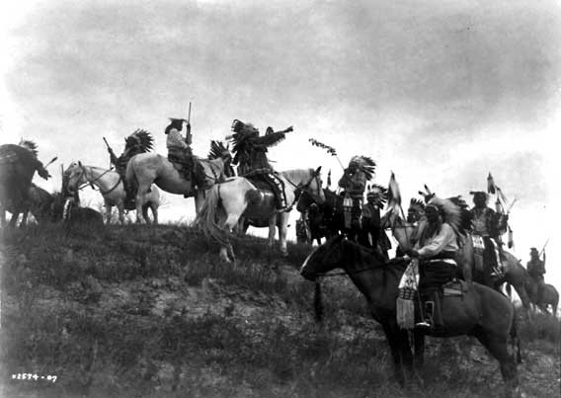
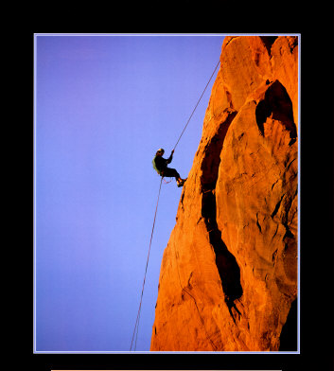
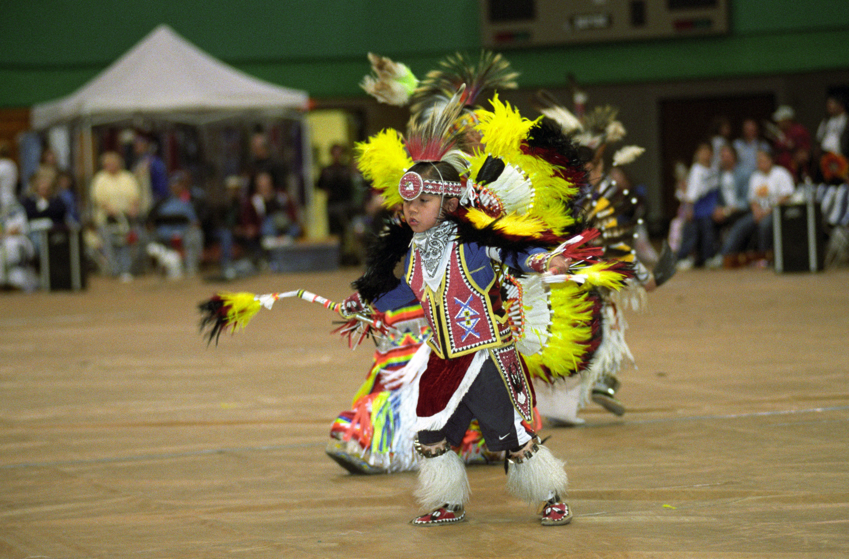
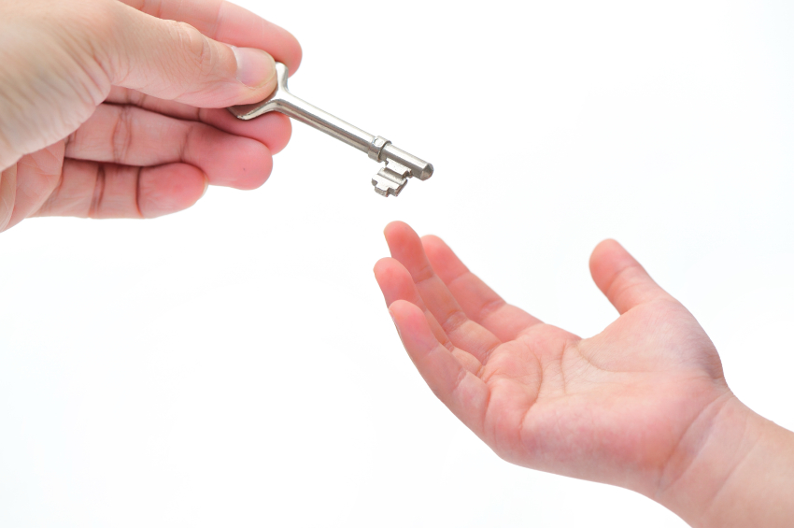
Vocabulary
Objective: We will define new vocabulary words.
custom: usual way followed by people of a particular group
determination: the quality of being firm in carrying out one’s plans
extended: enlarged; made to include more
inherited: received something from an ancestor
raid: an attack for the purpose of taking property
reputation: what others think about the character and behavior of someone
respect: feeling of admiration and approval

Slide 6
Vocabulary: We will insert words where they best fit the context.
Sioux warriors earned the for being brave, fierce, and powerful. They fought with courage and . They were also expert horsemen. A of a neighboring camp was likely to add to their herd.
Sioux warriors earned the of their enemies, but Sioux leaders also won the admiration of their people.
In traditional Sioux society, , traditions, and values were passed on from one generation to the next. One custom among the Lakota Sioux was the tradition of naming a baby only after watching the child to see what he or she was like. The family paid close attention to the way a child behaved. A boy who speed from his father might be given a name like “Runs-Fast-in-the-Morning.”
custom
determination
extended
inherited
raid
reputation
respect
Back to Day 1 Schedule

Slide 7
Drawing Conclusions
Objective: we will use facts and details to draw conclusions
Concept:
Prior Knowledge
Tell your partner what you know about Leigh from Dear Mr. Henshaw. What do you know about his character?
Importance
Drawing conclusions about characters and events will help us make predictions about what might happen next.
Implied information: information that is not directly stated in the selection
Drawing conclusions: adding up facts and details to come to an understanding of the implied information

Slide 8
Drawing Conclusions
Skill
I do
Detail + Detail = Conclusion
Revise old conclusions and draw new ones based on new facts and details.
Open your practice book to page 274.
Let’s read the first five paragraphs on page 471 in your textbook.
Detail
Returns Again and his wife give thanks when a son is born.
Detail
Returns Again hopes his son will hunt for the people and protect them.
Conclusion
The boy is born into a loving family who will help him grow up to be strong and brave.
+
=

Slide 9
Drawing Conclusions
We do
Closure
Let’s read pgs. 472-475 to find details which support the conclusion “Slow probably has the makings of a good leader.”
What do we call information that is not directly stated by the author?
What must we do to understand what the author is implying?
What conclusion can you draw concerning how Slow feels about his parents?
Practice: Continue filling in the chart on pg. 274
Back to Day 1 Schedule

Slide 10
Daily Language Practice
Ms Tamura was inable to reach my parents.
We were inaware that Julia, Mike and Liz were sick.
When Max enters the room yesterday, he felt the tenshun.
Back to Day 1 Schedule

Slide 11
Subject and Object Pronouns
Objective: We will identify and use subject and object pronouns
Concept
Prior knowledge
A boy sits on his horse.
What pronoun could replace “a boy”?
The horse is tall and swift.
What pronoun could replace “the horse”?
Two girls watch the boy.
What pronoun could replace “the boy”?
The boy calls to the girls.
What pronoun could replace “the girls”?
Pronoun: a word that replaces a noun
Subject pronoun: a pronoun which is the subject of the sentence.
I, you, he, she, it, we, they
Object pronoun: a pronoun which is an object of an action verb
me, you, him, her, it, them

Slide 12
Subject and Object Pronouns
Skill
I do
Use the pronouns: I, you, he, she, it, we, they as subjects. Subject pronouns come before verbs.
Use the pronouns: me, you, him, her, it, us, them as objects after action verbs.
We/Us are reading about the Lakota Sioux people.
How did I know to use “we”?
We do:
Aunt Ellen has a book about them/they.
How did we know to use “them”?

Slide 13
Subject and Object Pronouns
You do
Closure
I/me will tell a story about he/him.
How did you know which pronouns to use?
He/Him was an unusual child.
How did you know which pronoun to use?
What do we call pronouns which are the subject of a sentence?
What do we call pronouns that are the objects of action verbs?
The boy’s family saw how slowly he/him did everything.
They/Them gave the name Slow to he/him.
Independent Practice
Practice book pg. 283
Back to Day 1 Schedule

Slide 14
Day 2 Schedule
Reading
Segment 2 (478-484)
Drawing Conclusions
Practice book pg. 274
Comprehension questions (486)
Practice book pg. 275
Vocabulary
Practice book pg. 273
Word Work
Prefixes and suffixes
Spelling
Practice book pg. 279
Writing and Language
Daily Language Practice
Back to A Boy Called Slow

Slide 15
Prefixes and Suffixes
Prior Knowledge
Objective
Identify the prefix, or suffix, in each word:
returning
uncover
recollection
Does the affix change the meaning of the base word?
We will identify the meaning of words with prefixes and suffixes, and use them correctly in context.

Slide 16
Prefixes and Suffixes
Concept
Skill
Prefix: a word part that is placed before a base word
Un: a prefix meaning “not”
Dis: a prefix meaning “not”
In: a prefix meaning “not”
Re: a prefix meaning “again
Suffix: a word part that is placed after a base word
-ion: a suffix meaning “the act of”
Use context clues to help you determine which prefix or suffix and base word to use.
Say the word aloud to determine if it sounds correct.

Slide 17
Prefixes and Suffixes
dis- in- -ion
re- un-
+
accurate agreed aware cooperate direct like possess turned
I do
As they grew older, many of the boys began to their childhood names and wish for new ones.
We do
Returns Again earned his name when he to protect his people from an enemy raid.
You do
The low rumbling noise came from the of the trail.

Slide 18
Closure
Which prefixes mean “not”?
Which prefix means “again”?
Which suffix means “the act of”?
Which word best fits the context?
Returns Again with the others, who wanted to take out their weapons.
unagreed
disagreed
reagreed
Independent practice
Practice book pg. 278
Back to Day 2 Schedule

Slide 19
Daily Language Practice
Mr Holmes once wrote a televizion script for a comedy show.
I will called Ina tomorrow to find out her reacktion to the election results.
Back to Day 2 Schedule

Slide 20
Day 3 Schedule
Reading
Partner Read
Drawing Conclusions
Practice Book 276-277
Word Work
Spelling
Practice book pg. 280
Writing and Language
Daily Language Practice
Using I and me
Back to A Boy Called Slow

Slide 21
Daily Language Practice
We sent blankets, canned goods, and warm clothes, to the desaster victims.
Jillian and I plays basketball by the corect rules.
Please rimind Melina that she has an appointment with dr. Brown.
Back to Day 3 Schedule

Slide 22
Using I and Me
Prior Knowledge
Objective
He/Him sits on his horse.
They/Them watch he/him.
The boy calls to they/them.
We will use I and me correctly in sentences.
Importance: Understanding when to use each pronoun will improve your writing skills.

Slide 23
Using I and Me
Skill
I do
Use I as the subject of a sentence and after forms of be.
Use me after action verbs.
Use me after words like to, in, and for.
When using the pronouns I and me with nouns or other pronouns, name yourself last.
Wilton and went to day camp last summer.
How did I know which pronoun to use?

Slide 24
Using I and Me
We do
Closure
The counselors taught many skills to Wilton and .
Is the pronoun part of the subject?
Does it come after the verb?
Which pronoun should we use?
When do we use I?
When do we use me?
Complete the following:
Wilton, Ralph, and took archery together.
Rock-climbing was difficult for Ralph and .
My friends and shared the treats with our counselor.
Independent Practice
Practice book pg. 284
Back to Day 3 Schedule

Slide 25
Day 4 Schedule
Reading
“Drawn from History” (488-491)
Word Work
Spelling
Practice book pg. 281
Analogies
Writing and Language
Daily Language Practice
Back to A Boy Called Slow

Slide 26
Analogies
Prior Knowledge
Objective
Determine whether the following are antonyms or synonyms.
land and water
friend and enemy
friend and pal
We will identify the relationship between two pairs of words in an analogy.
We will complete analogies.

Slide 27
Analogies
Concept
Skill
Analogy: a type of sentence which expresses a comparison.
Example
Horse is to land as boat is to water.
Pattern
is to as is to
Determine the relationship between the first two items being compared. (synonyms or antonyms)
Finish the analogy with a word that has the same type of relationship with the word in the last part of the analogy.

Slide 28
Analogies
I do
We do
Friend is to enemy as pride is to .
First, figure out the relationship between the first 2 underlined words.
To finish the analogy I need a word that is an antonym of pride.
Bravery is to cowardice as fast is to .
Partner talk: what is the relationship between the first 2 underlined words?
What is the antonym of “fast”?
Dream is to vision as sleep is to .
Partner talk: what is the relationship between the first 2 underlined words?
What is the synonym of “sleep”?

Slide 29
Analogies
You do
Closure
Distrust is to suspicion as respect is to .
Horse is to mammal as lizard is to .
What type of sentence expresses a comparison?
What do we have to determine before we can complete an analogy?
Child is to human as colt is to .
Independent Practice
Practice book pg. 282
Back to Day 4 Schedule

Slide 30
Daily Language Practice
Nick and me were surprised by Nora’s serious expresstion.
The following repport was written by Talika and I.
Back to Day 4 Schedule

Slide 31
Day 5 Schedule
Reading
Comprehension Test
Vocabulary Test
Word Work
Spelling Test
Writing and Language
Practice book pg. 285
Back to A Boy Called Slow

