Slide 1
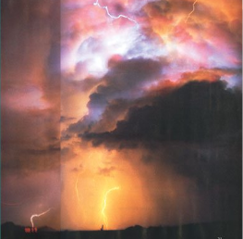
Nature’s Fury
Theme Concept: Nature is powerful, and people must cope with its challenges.

Slide 2
Nature’s Fury
Now the house of wind is thundering,
Now the house of wind is thundering,
As I go roaring over the land,
The land is covered in thunder.
~from “Wind Song”

Slide 3
Nature’s Fury
What do you think is the meaning of the theme title Nature’s Fury?
In what ways does the passage from “Wind Song” express nature’s fury?
Can you think of some examples of nature’s fury that have happened in this region? Elsewhere?
What are some things people can do to cope with nature’s fury?

Slide 4
Author: Peg Kehret
Illustrator: Phil Boatwright
Genre: realistic characters and events come to life in a fictional plot.
Day 1
Day 2
Day 3
Day 4
Day 5

Slide 5
Day 1 Schedule
Reading
Vocabulary
Read segment 1 (28-35)
Sequence of Events
Word Work
Spelling pre-test (51H)
Writing and Language
Daily Language Practice
Grammar: kinds of sentences
Back to Earthquake Terror

Slide 6
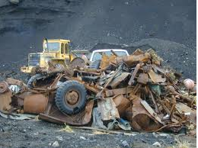
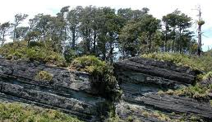
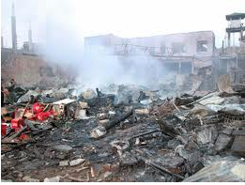
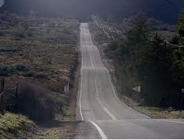
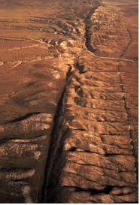
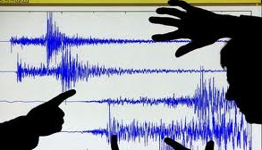
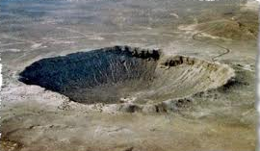
Vocabulary
We will define new vocabulary words.
Debris: the remains of something broken or destroyed
Devastation: destruction or ruin
Fault: a break in a rock mass caused by a shifting of the earth’s crust
Impact: the striking of one body against another
Jolt: a sudden jerk or bump
Shuddered: shook, vibrated, or quivered
Susceptible: easily affected
Undulating: moving in waves or with a smooth, wavy motion
Upheaval: a lifting or upward movement of the earth’s crust
Back to Day 1

Slide 7
Sequence of Events
Objective:
Prior Knowledge
We will identify the order of story events by using sequence signal words.
Tell your partner what you did this morning to get ready for school.
Did you start with the first thing you did, or the last?
Did you tell the events in the order in which they occurred?

Slide 8
Sequence of Events
Concept:
Example
Sequential order: the order in which story events occur
Signal words: words which give clues about the order of events
Sequential order: at first, then, next, finally
Happening at the same time: as, while, at the same time
At age 10, Lance Armstrong first began training as a cyclist. In high school he joined the U.S. Olympic team. Then in 1999, he won the Tour de France.
R: What are signal words?
A: Which of the following is in sequential order?
a) I went to the store looking for cookies.
b) After I went to the store, I met my sister for lunch.
J: How do you know?

Slide 9
Sequence of Events
Importance
Analyzing text that is written in chronological order will help you understand what the author is trying to say.
It will improve your writing.
Why do you think this is important?

Slide 10
Sequence of Events
Skill
I do
As you read, think of the events which have occurred.
Look for signal words, they will tell you the order in which things are happening.
Pay special attention to events which are happening at the same time.
“Jonathan noticed again how quiet it was. No magpies cawed, no leaves rustled overhead. The air was stifling, with no hint of a breeze. Then, Moose barked.” (pg. 32)
1. What happened before Moose barked?

Slide 11
Sequence of Events
Skill
We do
As you read, think of the events which have occurred.
Look for signal words, they will tell you the order in which things are happening.
Pay special attention to events which are happening at the same time.
Let’s read the first paragraph on page 32.
What events are happening at the same time?
How do you know?

Slide 12
Sequence of Events
Closure
Independent Practice
What do we call the order in which events occur?
Which of the following shows the correct order of events on page 33?
There was a jolt, Abby screamed, Jonathan dropped the leash.
He dropped the leash, Abby screamed, he thought there was a bomb
What is one thing you learned about sequential order?
Practice book pg. 4
Back to Day 1

Slide 13
Daily Language Practice
Did you tie the boat to the doct
take a deep breeth before you begin.
The mayor will set up a fuhnd for the flood victims!
Back to Day 1

Slide 14
Grammar: Kinds of Sentences
Objective
Prior Knowledge
We will identify the four kinds of sentences.
How might I sound if I was very excited about something?
How about if I was confused and needed to get information?

Slide 15
Concept
Examples
Declarative sentence: tells something. It ends with a period.
Interrogative sentence: asks a question. It ends with a question mark.
Imperative sentence: gives a request or an order. It usually ends with a period.
Exclamatory sentence: expresses strong feeling. It ends with an exclamation point.
An earthquake can be very dangerous.
Have you ever felt the ground move?
Stay calm during an earthquake.
What a scary feeling that must be!
R: What does an interrogative sentence do?
A: Which is the imperative sentence?
a) He struggled to his feet.
b) Put your hands over your head.
J: How do you know?

Slide 16
Guided Practice
Skill
I do
Determine what the sentence does.
Add the appropriate punctuation.
Identify the type of sentence.
Do you know what to do during an earthquake
The sentence is asking a question, so I need to add a question mark.
A question is called an interrogative sentence.

Slide 17
Guided Practice
Skill
We do
Determine what the sentence does.
Add the appropriate punctuation.
Identify the type of sentence.
Try to find shelter as quickly as possible
What should we do first?
What type of punctuation should we use?
What type of sentence is this?

Slide 18
Closure
Independent Practice
What do we call a sentence that expresses a strong feeling?
Which of the following is a declarative sentence?
How silent it is right after an earthquake!
An earthquake can stop as suddenly as it can start.
What is one thing you learned today?
Practice book pg. 13
Back to Day 1

Slide 19
Day 2 Schedule
Reading
Segment 2 (36-44)
Sequence of Events
Complete practice book pg. 4
Comprehension Questions (pg. 46)
Vocabulary practice
Practice book pg. 3
Word Work
Base words (51e)
Spelling
Practice book pg. 9
Writing and Language
Daily Language Practice
Back to Earthquake Terror

Slide 20
Base Words
Objective:
Concept:
We will identify base words, prefixes, and suffixes.
Base word: a word which can stand alone or to which endings, prefixes, and suffixes can be added
Prefix: a word part added to the beginning of a base word
Suffix: a word part added to the end of a base word.
R: What is a base word?
A: Which of the words has a suffix?
a) connecting
b) disconnect
J: How do you know?

Slide 21
Base Words
Importance
Skill
Recognizing base words can help us figure out unfamiliar words.
Remove any prefixes and suffixes.
Change the spelling of the base word if necessary (sometimes the spelling changes when an ending is added.
I do
Time seemed to go faster while Jonathan was cataloging his baseball cards.

Slide 22
Base Words
Skill
We do
Remove any prefixes and suffixes.
Change the spelling of the base word if necessary (sometimes the spelling changes when an ending is added.
Air whizzed across Jonathan as the tree trunk dropped past, and branches brushed his shoulder.
Whizzed:
Dropped:
Branches:
Brushed:

Slide 23
Base words
Closure
Independent Practice
What do we call words that can stand alone, or have prefixes and suffixes added?
What is the base word of sobbing?
sobb
sob
What is one thing you learned?
Practice book pg. 8
Back to Day 2

Slide 24
Daily Language Practice
watch out for that dich!
The two boys sleept until noon?
Back to Day 2

Slide 25
Day 3 Schedule
Reading
Mood (39)
Sequence of events
Practice book pg. 6-7
Word Work
Spelling
Practice book pg. 10
Writing and Language
Daily Language Practice
Subjects and Predicates
Back to Earthquake Terror

Slide 26
Daily Language Practice
Who swepped the leaves under the fence.
Be careful not to cresh your fingers in the car door?
Justin and amanda shared a buhch of bananas.
Back to Day 3

Slide 27
Subject and Predicates (51k)
Objective
Prior Knowledge
We will identify complete and simple subjects and predicates.
The earthquake caused a great deal of damage.
What caused a great deal of damage?
What is the verb in this sentence?

Slide 28
Concept
Example
Subject: tells whom or what the sentence is about.
Complete subject: includes all the words in the subject.
Predicate: tells what the subject is or does.
Complete predicate: includes all the words in the predicate.
The earthquake caused a great deal of damage.
Subject: earthquake
Complete subject: The earthquake
Predicate: caused
Complete predicate: caused a great deal of damage.
R: What is a complete predicate?
A: What is the complete subject of the following sentence: Many tornadoes happen during the month of April.
a) Many tornadoes
b) tornadoes
J: How do you know?

Slide 29
Guided Practice
Skill
I do
Who or what is the sentence about?
The one word the sentence is about is the simple subject.
The complete subject includes any descriptive words
What is the action of the sentence?
The verb by itself is the simple predicate.
The complete predicate contains all words in the predicate.
Thunderstorms do not always produce tornadoes.

Slide 30
Guided Practice
Skill
We do
Who or what is the sentence about?
The one word the sentence is about is the simple subject.
The complete subject includes any descriptive words
What is the action of the sentence?
The verb by itself is the simple predicate.
The complete predicate contains all words in the predicate.
Certain weather conditions cause these storms.
Simple subject:
Complete subject:
Simple predicate:
Complete predicate:

Slide 31
Subjects and Predicates
Closure
Independent Practice
What do we call the action part of a sentence?
What is the simple predicate? The complete predicate?
Tornadoes can destroy very heavy objects in their path.
What is the most important thing you learned in this lesson?
Practice book pg. 14
Back to Day 3

Slide 32
Day 4 Schedule
Reading
“El Nino” (48-51)
Print and Electronic Reference Sources (51d)
Word Work
Spelling
Practice book pg. 11
Using a Thesaurus (51i)
Writing and Language
Daily Language Practice
Back to Earthquake Terror

Slide 33
Print and Electronic Reference Sources
Objective:
Prior Knowledge
We will identify the appropriate reference source to answer a specific question.
If you have a question about your math homework, what book could you use to find the answer?
What about if you need to look up the phone number for the local library?

Slide 34
Print and Electronic Reference Sources
Concept:
Importance
Atlas: a reference containing maps
Encyclopedia: a reference book containing in depth information on all subjects
Thesaurus: a reference containing synonyms
Dictionary: a reference containing pronunciation guides and definitions of words
Knowing which reference material to use will help you in all of your future classes.
Many careers require use of print and electronic reference sources.

Slide 35
Print and Electronic Reference Sources
Skill:
I do:
Determine what type of information needs to be found.
Identify what each reference source is used for.
Use the source that best fits your needs.
You need to find a climate map of Australia. Which reference would best meet your needs?

Slide 36
Print and Electronic Reference Sources
Skill:
We do:
Determine what type of information needs to be found.
Identify what each reference source is used for.
Use the source that best fits your needs.
Your need to do research on the state of California. What reference source would you use?

Slide 37
Closure
What reference do we use to find synonyms?
Which reference would you use to find the pronunciation of a word?
Thesaurus
Dictionary
Atlas
Encyclopedia
Back to Day 4

Slide 38
Using a Thesaurus
Objective:
Prior Knowledge
We will use a thesaurus to find synonyms for specific words
Record a synonym for each word:
Cold
Good

Slide 39
Concept:
Importance:
Thesaurus: a reference tool which is used to find a synonym to replace an overused word.
Using a thesaurus will help us make our writing clearer and more interesting.

Slide 40
Skill:
I do:
Look up the word you would like to replace (words are listed alphabetically).
Choose the synonym that best fits your need.
Find a synonym for the word terrible.
We do:
Find synonyms for the underlined words:
Time had a way of evaporating instantly when he was engrossed in an interesting project.

Slide 41
Using a Thesaurus
Closure:
Independent practice
What reference tool do we use to find synonyms?
What is a synonym for devastating?
creation
destruction
What is one important thing you learned in this lesson?
Practice book pg. 12
Back to Day 4

Slide 42
Daily Language Practice
Did the staf tell you when your puppy could come home.
is she fonde of chocolate chip cookies?
Back to Day 4

Slide 43
Day 5 Schedule
Reading
Comprehension test
Vocabulary test
Word Work
Spelling test
Back to Earthquake Terror

