Slide 1
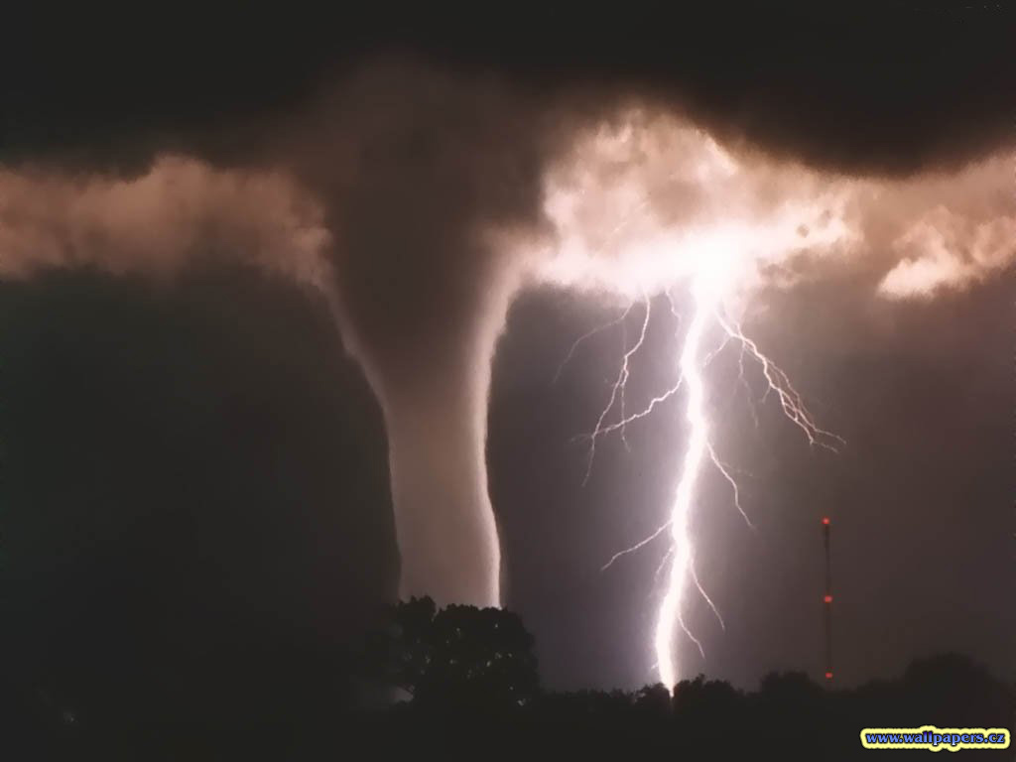
Eye of the Storm: Chasing Storms with Warren Faidley
Author: Stephen Kramer
Photographer: Warren Faidley
Genre: nonfiction
Day 1
Day 2
Day 3
Day 4
Day 5

Slide 2
Day 1
Reading
Teacher Read Aloud
Vocabulary
Text Organization (81a)
Read Segment 1 (57-68)
Word Work
Pretest (81g)
Writing and Language
Daily Language
Conjunctions (81k)
Back to Home Screen

Slide 3
Vocabulary
Collide: to bump into another mass with force
Funnel cloud: tornado cloud that is wide at the top and narrow where it touches the ground
Jagged: having a sharp, pointed edge or outline
Lightning: the flash of light in the sky when electricity passes between clouds or between a cloud and the ground
Prairies: flat, open grasslands
Rotate: to swirl in a circular motion
Severe: serious or extreme in nature
Sizzling: crackling with intense heat
Tornadoes: rotating columns of air accompanied by whirling funnel-shaped downspouts that can cause great destruction

Slide 4
Vocabulary activity We will choose the correct vocabulary word based on the context clues.
Collide, funnel cloud, jagged, lightning, prairies, rotate, severe, sizzling, tornadoes
Every spring, warm air from the Gulf of Mexico and cool air from Alaska (1) over the midwest. Powerful weather can brew over the flat (2) when these air masses meet. Today the National Weather service issued a (3) storm warning for northern Texas and Oklahoma. (4) are likely to touch down in this region throughout the weekend. These signs show that a tornado may be forming:
*Air at the bottom of a dense, inky cloud begin to (5)
*One or more (6) descend toward the ground like dragon necks.
Tornadoes are often accompanied by (7) electrical storms. It is not unusual to see (8) bolts of (9) .
Back to Day 1 Schedule

Slide 5
Text Organization We will identify how the author has organized information in a nonfiction selection
Practice book pg. 24
Pages 59-68
Page 59 Storm Chasing
Page 60 Warren Faidley: Storm Chaser
Page 64 What Happens to Warren’s Photos After He Takes Them
Page 65 Storm Seasons and Chasing
Page 67 Chasing Tornadoes
Back to Day 1 Schedule

Slide 6
Daily Language Practice We will proofread and correct sentences with grammar and spelling errors
the crowd cheered when the spech was over.
The beest walked quickly but it did not run.
I will call my neice, or i will write to her.
Back to Day 1 Schedule

Slide 7
Conjunctions We will identify and use conjunctions
Concept:
Conjunction: a combining or connecting word (and, but, or)
May be used to join words in a sentence
May also be used to join sentences
Example:
Jill looked at the thermometer and the barometer.
What is a conjunction?
The word “and” is a conjunction, how do you know?
Importance: Understanding how and when to use conjunctions will help improve your writing and editing skills.

Slide 8
Conjunctions We will identify and use conjunctions
Skill:
Use and to add information.
Clouds signal a coming storm.
Wind signals a coming storm.
Clouds and wind signal a coming storm. (The conjunction joined words)
Use or to give a choice.
She will go to the store.
She will go to a movie.
She will go to the store, or she will go to a movie. (Joined sentences)
Use but to show contrast.
He wanted to eat a cookie.
He ate a carrot instead.
He wanted to eat a cookie, but he ate a carrot instead. (Joined sentences)

Slide 9
Conjunctions We will identify and use conjunctions
I do
She had to hurry, she would be late.
What was combined?
We do
Jill was going to visit the museum the planetarium.
What was combined?
You do
There would be a lot to see, Jill knew they could not explore the whole museum in one visit.
What was combined?

Slide 10
Conjunctions We will identify and use conjunctions
Closure
What do conjunctions do?
What are three conjunction words?
What do each of the conjunctions do?
Independent Practice
Practice book page 33
Back to Day 1 Schedule

Slide 11
Day 2
Reading
Segment 2 (69-75)
Text organization
Comprehension questions (76)
Vocabulary
Practice book pg. 23
Word work
Syllabication (81e)
Spelling
Practice book pg. 29
Writing and Language
Daily language
Response to a prompt (81m)
Back to Home Slide

Slide 12
Text Organization We will identify how the author has organized text in a nonfiction selection.
Practice book page 24
Pages 69-75 One Day in the Life of a Storm Chaser
Morning
Afternoon
Evening
Back to Day 2 Schedule

Slide 13
Syllabication We will break words into syllables
Concept:
Syllables: a word part with just one vowel sound
Importance: Breaking a long word into its syllables will help you decode the word, and will help you with spelling the word.
Skill:
Write a V under each vowel sound
Write a C under each consonant sound
If it is a VCCV pattern, the syllable break is between the consonants.
Most VCV words divide after the consonant, unless the vowel is a long vowel
If it is a CVVC word, divide between the vowels unless they make one sound

Slide 14
Syllabication We will break words into syllables
I do:
cactus nature diary
We do:
camera radio spectacular
You do:
Tornado horizon remarkable

Slide 15
Syllabication We will break words into syllables
Closure
What is a syllable?
Break the following word into its syllables
organizing
Independent Practice
Practice book page 28
Back to Day 2 Schedule

Slide 16
Daily Language Practice We will proofread and correct sentences with grammar and spelling errors
The weather has been maild all winter
The theef jumped up but he could not climb the fence.
Back to Day 2 Schedule

Slide 17
Response to a prompt We will identify the characteristics of a written response. We will use the characteristics to write a response.
Concept:
Writing prompt: a direction that asks for a written answer of one or more paragraphs
Types of writing prompts:
Write about an experience
Give a personal opinion about an issue
Explain a process
Persuade readers to do or think something
Importance: Writing prompts are a part of many different tests you will take. Learning how to respond to a prompt will help you throughout your school experience.

Slide 18
Response to a prompt We will identify the characteristics of a written response. We will use the characteristics to write a response.
Skill:
Carefully read the prompt.
Highlight key words that tell what kind of answer is needed.
Compare (point out similarities)
Contrast (point out differences)
Explain (give reasons)
Describe (give details)
Summarize (give main points briefly)
Discuss (consider all aspects of a subject)
Plan your answer: jot down main ideas and details, arrange your ideas in order.
Begin your answer by restating the prompt.
Check your answer. Does your response answer the prompt?
Edit if necessary.

Slide 19
Response to a prompt We will identify the characteristics of a written response. We will use the characteristics to write a response.
I do:
What natural disaster do you think is the most dangerous, an earthquake or a tornado? Explain why you think it is more dangerous?
We do:
Think about how Warren Faidley customized Shadow Chaser for chasing tornadoes. Describe how you would customize a vehicle for a specific task.
What job do you think is the most difficult or dangerous? Explain why you think it is difficult or dangerous?

Slide 20
Response to a prompt We will identify the characteristics of a written response. We will use the characteristics to write a response.
Closure:
What are some of the key words to look for when reading a prompt?
If you are asked to compare and contrast earthquakes and tornadoes, what are you being asked to do?
Independent Practice:
Use practice book page 36 to plan a response to one of our prompts.
Write a one paragraph response.
Back to Day 2 schedule

Slide 21
Day 3
Reading
Partner reading
Suspense (61)
Text organization
Practice book pg. 26, 27
Word work
Spelling
Writing and Language
Daily Language
Compound sentences (81k)
Back to Home Slide

Slide 22
Spelling Practice We will correctly spell each spelling word
Flower, stem,
Reward, honor,
Hit, punch,
Herd, team,
Step, walk,
Cousin, uncle,
Spot, smudge,
Small, light,
Monster, dragon,
Length, width,
Independent practice: Practice book page 30
Back to Day 3 Schedule

Slide 23
Daily Language Practice We will proofread and correct sentences with grammar and spelling errors
The spill on the rug left a huge stane
this backpack has a belt that fits around my wast.
Can you read the words on that sine
Back to Day 3 Schedule

Slide 24
Compound Sentences We will use conjunctions to create compound sentences
Prior knowledge:
Combine the following using and, but, or, or
Katie went to the store. Joe went to the store
Megan wanted spaghetti. Jenn wanted enchiladas.
Concept:
Compound sentence: a sentence containing 2 independent clauses which are combined with a comma and a conjunction.
Independent clause: a statement that can stand on its own as a sentence.
Example:
The sky darkened in the west, and a chill wind whistled across the plains.
What 2 sentences have been combined? With what conjunction?
Jill buttoned up her coat and walked out into the yard.
This is not a compound sentence, how do you know?
Importance:
Using conjunctions to create compound sentences will improve your writing.

Slide 25
Compound Sentences We will use conjunctions to create compound sentences
Skill:
Read the sentences.
Ask yourself, “Are the sentences related?”
If they are related, use a comma and the conjunction and, but, or or to combine the sentences.
Remember:
And means you are adding information
Or gives a choice
But provides a contrast

Slide 26
Compound Sentences We will use conjunctions to create compound sentences
I do:
The air is hazy. Another storm to the west is blocking the sunlight.
We do:
Warren tries to photograph a huge tornado. The light isn’t good enough for a picture.
You do:
We’ve got two large thunderstorms here. They’re dropping tornadoes everywhere.

Slide 27
Compound Sentences We will use conjunctions to create compound sentences
Closure:
What are compound sentences?
What connects the 2 independent ideas of a compound sentence?
Combine the following into a compound sentence:
Warren Faidley takes amazing pictures. His work appears in many magazines.
Independent Practice:
Practice book page 34
Back to Day 3 Schedule

Slide 28
Day 4
Reading
Partner read
Storm warning (78-81)
Communicating Information (80)
Word Work
Spelling
Practice book pg 31
Alphabetical order (81I)
Practice book 32
Writing and Language
Daily language
Capitalizing sentences (81n)
Practice book page 37
Back to Home Slide

Slide 29
Daily Language Practice We will proofread and correct sentences with grammar and spelling errors
do you see the large flet of boats in the harbor?
The hite of the shelf is ten feet but my cat can reach the top.
Back to Day 4 schedule

Slide 30
Day 5
Reading
Fact and opinion (65)
Comprehension test
Word Work
Spelling test
Writing and Language
Run-ons (81L)
Practice book page 35
Back to Home Slide

