Slide 1
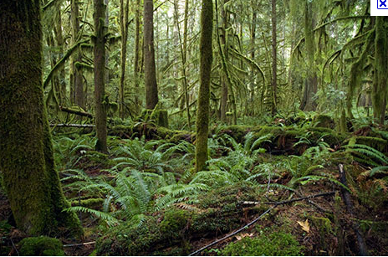
The Golden Lion Tamarin Comes Home
Author: George Ancona
Genre: nonfiction ~ an expository nonfiction selection about golden lion tamarins
Day 1
Day 2
Day 3
Day 4
Day 5

Slide 2
Day 1
Reading
Vocabulary
Read Segment 1 (629-635)
Story Structure
Word Work
Spelling pre-test (647g)
Writing and Language
Daily Language Practice
Prepositions
Expository Writing: Compare/Contrast
Day 1: Introduce the Model (647M)
Back to Golden Lion

Slide 3
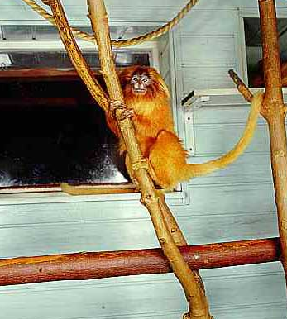
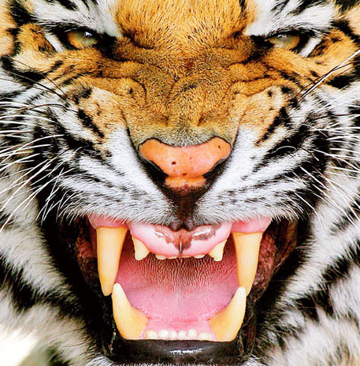
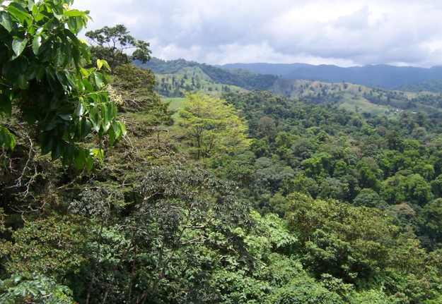
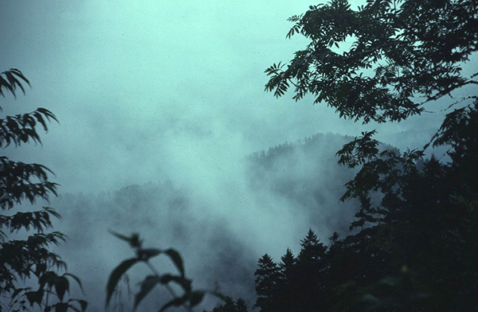
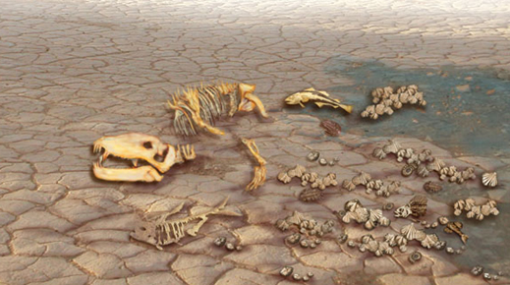
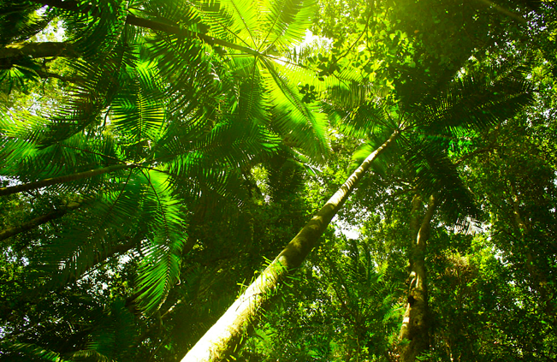
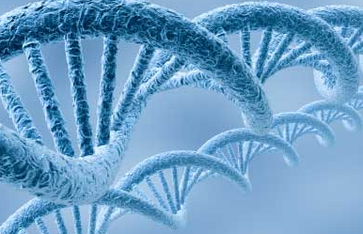
Vocabulary
We will define new vocabulary words.
Habitat: a natural environment for native creatures
Humid: containing a large amount of water vapor
Observation: the act of paying close attention
Predators: animals that prey on others
Reintroduction: the process of returning animals to their native habitats.
Canopy: the high, sheltering branches of rain forest trees.
Captive: captured; held against one’s will
Dilemma: a situation in which one is given difficult choices to make
Extinction: the condition of having died out
Genes: tiny piece of matter in cells that carry the blueprints for characteristics

Slide 4
We will insert words where they best fit the context.
Observation Log
Date: May 14, 1999
Place: Poco das Antas Biological Reserve, Brazil
Goal: To monitor the reintroduction process for a family of golden lion tamarins released into the wild three weeks ago.
Our dilemma has been how to blend six tamarins from two different zoos into one family without intruding in the animals’ lives. If we are successful in bringing the tamarins together, it will strengthen the animals’ genes and help prevent their extinction.
Notes:
8:10 A.M.: Morning air already hot and humid. So far, no sign of any of the captive tamarins released into the area 3 weeks ago.
8:25 A.M.: Saw one ocelet. Tamarins still hidden; they may be trying to avoid this predator.
9:40 A.M.: Spotted two tamarins above me in the forest canopy.
canopy
captive
dilemma
extinction
genes
habitat
humid
observation
predators
reintroduction
Back to Day 1

Slide 5
Story Structure
Objective
Prior Knowledge
We will identify the topic, main ideas, and key details in the selection.
Tell your partner what “Grizzly Bear Family Album” was about in 1 or 2 words.
What was the main point the author was trying to get across?

Slide 6
Topic, Main Idea, Key Details
Concept
Example
Topic: the subject all or most of the paragraphs in a selection tell about. It can usually be expressed in one or two words.
Main idea: the most important idea or point the author makes about the topic.
Key details: support or explain the main idea
Topic: Stage fright
Main idea: Stage fright is a common affliction, even among professional actors.
Key detail: a recent survey concluded that 3 out of 5 actors regularly suffer from stage fright.
R: What is a main idea?
A: Which of the following is a topic?
a) Grizzly bears are feared by many people.
b) grizzly bears
J: How do you know?

Slide 7
Importance
Your first task as a reader is to understand the author’s point.
Understanding the structure of a selection will help you comprehend what the author is trying to communicate.

Slide 8
Topic, Main Idea, Key Details
Skill
I do (practice book pg. 368)
Look for a stated main idea.
If it is not stated, consider the overall section.
What is the entire section talking about?
What information supports the main idea?
The information could be facts or opinions.
Let’s reread pg. 630 together.
I don’t see a stated main idea, so what is the entire page about?
It seems to be a description about the tamarins’ environment.
Main idea: The natural habitat of the tamarins is a diverse and colorful environment.
Supporting details: birds sing, insects buzz, cicadas chirp; tangled vines and leaves; orange-gold flash; speckles of light.

Slide 9
Topic, Main Idea, Key Details
Skill
We do
Look for a stated main idea.
If it is not stated, consider the overall section.
What is the entire section talking about?
What information supports the main idea?
The information could be facts or opinions.
Let’s reread pg. 632-633 together.
Is there a stated main idea?
What do these pages seem to be about?
What main idea should we record?
What details support this idea?

Slide 10
Topic, Main Idea, Key Details
Closure
Independent Practice
What are key details?
Which of the following is a main idea?
Tamarins need special training before be reintroduced to the wild.
Training includes practicing with ropes that simulate vines.
What is one thing you learned about topic, main idea, and key details?
Fill in the main idea and details for pages 634-635.
Back to Day 1

Slide 11
Daily Language Practice
The kayakers paddled skillfully through dangerous hamilton gorge.
Your father and I will sells the proporty as soon as possible.
Dr Provine explained that my skin is very sensitiv to heat and sun.
We will proofread and correct sentences with grammar and spelling errors.
Back to Day 1

Slide 12
Prepositions
Objective
Prior Knowledge
We will identify prepositions and their objects.
An eagle soars above the tree.
Where does the eagle soar?
A monkey crouches in the tree.
Where does the monkey crouch?
A frog hops beneath the tree.
Where does the frog hop?

Slide 13
Prepositions
Concept
Example
Preposition: a word which relates the noun or the pronoun that follows it to another word in the sentence. It can answer the questions where, or how.
Object: the noun or the pronoun that follows the preposition
The frog leaps into the pond.
“into” connects the frog to the pond.
The frog leaps into the pond.
pond is the object because it follows the preposition
R: What is a preposition?
A: What is the object? The eagled dives toward a fat rodent.
a) toward
b) fat rodent
J: How do you know?

Slide 14
Prepositions
Skill
I do
Underline the preposition.
Circle the object.
Common prepositions:
About, above, across, after, along, around, at, before, behind, below, beside, by, down, during, except, for, from, in, inside, into, near, of, off, on, out, outside, over, past, through, to, under, until, up, with, without
The monkey hangs from the branch.
“from” answers the question: where?
“branch” follows the preposition, so it is the object.
How did I know which word was the object?

Slide 15
Prepositions
Skill
We do
Underline the preposition.
Circle the object.
Common prepositions:
About, above, across, after, along, around, at, before, behind, below, beside, by, down, during, except, for, from, in, inside, into, near, of, off, on, out, outside, over, past, through, to, under, until, up, with, without
The eagle snags the rodent with its claws.
What word is the preposition?
Which question does it answer?
What is the object?
How did you know?

Slide 16
Prepositions
Closure
Independent Practice
What word relates the noun or pronoun that follows it to another word in the sentence?
Which word is the object
The monkey quickly reaches the top of the tree.
tree
of
What did you learn about prepositions and objects?
Practice book pg. 377
Back to Day 1

Slide 17
Introduction
Tamarins are an endangered species. Zoos around the world are cooperating to reintroduce tamarins raised in captivity back into their natural habitat in Brazil. However, life for golden lion tamarins in a zoo is very different from life in their natural habitat.
First of all, in a zoo, food and shelter are provided, and the tamarins do not have to learn wilderness survival behaviors. A familiar human delivers chopped fruit in a bowl to the tamarins an a safe, enclosed living area. The tamarins climb up fixed poles that do not sway under their weight. No predators enter their safe environment, so they do not have to learn to avoid any other animals. They are sheltered from severe weather.
On the other hand, tamarins in the wild must forage for their own food, avoid predators including human hunters and poachers, avoid poisonous foods and snakes, find shelter from storms, live out in the open, and move among tree limbs and vines that sway and bend when they jump onto them.
Whether the tamarins live in the zoo or in the wild in Brazil, they are all endangered. All are counted and observed very carefully. The fur of individuals and families is marked with dyes, and the tamarins, especially those being introduced to the wild, wear radio collars to help observers locate, track, and study them. Scientists hope that gradually more and more golden lion tamarins will survive and raise families their natural rain forest habitat.
Contrast
zoo
Contrast
natural
Comparison
Concluding
Back to Day 1

Slide 18
Day 2
Reading
Segment 2 (636-641)
Story Structure
Complete practice book pg. 368
Comprehension Questions
Independent Practice
Vocabulary ~ practice book pg. 367
Word Work
Syllabication
Practice book pg. 372
Spelling
Practice book pg. 373
Writing and Language
Daily Language Practice
Expository Writing: Compare/Contrast
Day 2: Prewriting (647M)
Practice book pg. 380
Back to Golden Lion

Slide 19
Comprehension Questions (use TAPPLE strategies)
Do you think the settlers’ reasons for cutting down the rain forest were good ones? Why or why not?
Why do you think tamarins born in the wild do better than tamarins who return to the rain forest after living in captivity? (RC 2.3, 2.4)
Find evidence in the text to support this idea: Tamarins need the most help just after they return to the rain forest. (W 2.2)
Do you agree with the observers’ decision on page 639 not to name the tamarins? Why or why not? (RC 2.4)
Do you think the efforts to return tamarins to the forest are worthwhile, even though only 30% of them survive? Explain. (RC 2.4)
Which animal’s survival do you feel more hopeful about – the grizzly’s or the golden lion tamarin’s? Why? (LRA 3.4)
Independent Practice:
Practice book pg. 369
Back to Day 2

Slide 20
Daily Language Practice
Our reguler coach, Joe rockwell, is sick today.
Last year our family plan a vacashun to the coast of Maine.
We will proofread and correct sentences with grammar and spelling errors.
Back to Day 2

Slide 21
Day 3
Reading
Story Structure
Practice Book pg. 370-371
Word Work
Spelling
Practice book pg. 374 (independent/homework)
Writing and Language
Daily Language Practice
Prepositional phrases
Expository Writing: Compare/Contrast
Day 3: Drafting (647N)
Transparency 6-15
Back to Golden Lion

Slide 22
Daily Language Practice
Vegetables weren’t my favarite food when i was younger.
We have tried to edjukate my dog skippy, but he still chases cars.
My collection of boston Red Sox baseball caps isn’t in very good condision.
We will proofread and correct sentences with grammar and spelling errors.
Back to Day 3

Slide 23
Prepositional Phrases
Objective
Prior knowledge
We will identify and write prepositional phrases.
Identify the preposition and object in each sentence:
An eagle soars above the river.
A frog prepares to leap into the pond.
A monkey crashes through the jungle.

Slide 24
Prepositional Phrases
Concept
Example
Prepositional phrase: is made up of a preposition, the object of the preposition, and all the words in between.
In the early morning the deer are thirsty.
“in” is the preposition
“morning” is the object
prepositional phrase = in the early morning
R: What makes up a prepositional phrase?
A: In which sentence is the prepositional phrase underlined?
a) The heat of the midday sun drives some creatures underground.
b) The deer find shade in a narrow canyon.
J: How do you know?

Slide 25
Prepositional Phrases
Skill
I do
Underline the preposition.
Circle the object.
Write the prepositional phrase.
The naturalist took a photograph of the rain forest’s canopy.
First, I underline the preposition.
Next, I circle the object.
The prepositional phrase is: of the rain forest’s canopy.

Slide 26
Prepositional Phrases
Skill
We do
Underline the preposition.
Circle the object.
Write the prepositional phrase.
Then she saw a golden lion tamarin resting in the shadows.
What should we underline?
What is the object?
Record the prepositional phrase on your whiteboard.
How did we know?

Slide 27
Prepositional Phrases
Closure
Independent Practice
What do we call a preposition, its object, and all the words in between?
Identify the prepositional phrase:
In a nearby tree she spotted another one.
What did you learn about prepositional phrases?
Identify the prepositional phrases:
At dusk she waited patiently with her guide.
A tamarin in its natural habitat is not easy to photograph.
Practice book pg. 378
Back to Day 3

Slide 28
Back to Day 3

Slide 29
Day 4
Reading
“Tuning in on Animals” (644-647)
Word Work
Spelling
Practice book pg. 375 (independent)
Word Histories: capere (347j)
Writing and Language
Daily Language Practice
Expository Writing: Compare/Contrast
Day 4: Revising (647N)
Back to Golden Lion

Slide 30
Daily Language Practice
Mr. and Mrs Chen called our attenshun to the Chinese scrolls in the museum.
Last night Scott asks me what homework we had for hiztory class.
We will proofread and correct sentences with grammar and spelling errors.
Back to Day 4

Slide 31
Day 5
Reading
Comprehension Test
Vocabulary Test
Word Work
Spelling Test
Writing and Language
Practice book pg. 379
Expository: Compare/Contrast
Day 5: editing (647N)
Back to Golden Lion

