Slide 1
Animal Encounters
Theme Concept: People and wild animals interact in a variety of close encounters.

Slide 2
Animal Encounters
The great hurrah about wild animals is that they exist at all, and the greater hurrah is the actual moment of seeing them.
~ Annie Dillard
Pilgrim at Tinker Creek

Slide 3
Animal Encounters
How does the author of the quotation seem to feel about the experience of seeing animals in the wild?
What wild animals have you seen in their natural environment?
What was the experience like?
What are some different reasons why people might want to come into close contact with a wild animal?
Describe some of the dangers people might face and the precautions they should take when encountering animals in the wild.

Slide 4
The Grizzly Bear Family Book
Author: Michio Hoshino
Genre: nonfiction ~ expository nonfiction selection about grizzly bears.
Day 1
Day 2
Day 3
Day 4
Day 5

Slide 5
Day 1 Schedule
Reading
Vocabulary
Read Segment 1 (602-609)
Identifying Generalizations
Word Work
Spelling pre-test (623g)
Writing and Language
Daily Language Practice
Grammar: Contractions with not
Persuasive Writing: Opinion
Day 1: Introduce the Model
Back to Grizzly Bear

Slide 6
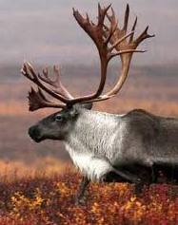
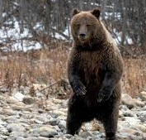
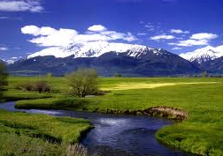
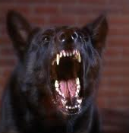
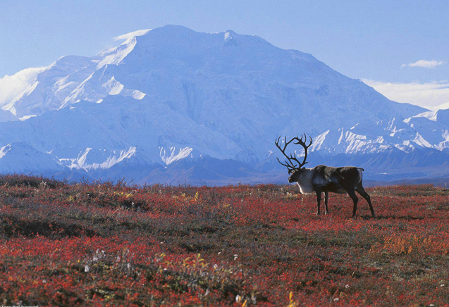
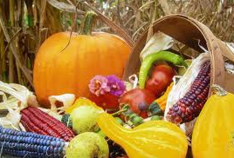
Vocabulary
We will define new vocabulary words.
Abundant: more than enough; plentiful
Aggressive: bold; ready and quick to fight
Carcass: dead body of an animal
Caribou: a type of arctic deer
Subservience: the state of being willing to yield to others’ power
Territory: an area inhabited by an animal or animal group and defended against intruders
Tundra: a treeless Arctic region where the subsoil is permanently frozen and where only low shrubs, lichens, and mosses can grow.
Wariness: the state of being on one’s guard
Wilderness: any unsettled region in its natural state

Slide 7
We will insert words where they best fit the context.
Welcome to Denali National Forest
We hope you enjoy your visit to this beautiful and unspoiled wilderness. These tips will help you have a safe and pleasant stay.
Tips for Wilderness Travelers
You are likely to see abundant wildlife, including moose, Dall sheep, grizzly bears, and herds of caribou. Many small creatures live in the grasses of the tundra, including ground squirrels and shrews. So keep your binoculars and your camera handy.
Please remember that grizzly bears make this land their home. When hiking in bear territory, be careful. A certain amount of wariness will help prevent unpleasant encounters with grizzlies. If you see a bear cub, stay away! Mother grizzlies become aggressive when their cubs are approached. If you see a bear eating the dead carcass of an animal, steer clear!
You might be lucky enough to see an encounter between two wild animals. Often when wild animals meet, they fight for dominance. The loser shows subservience by leaving the area. If you see such an encounter, keep your distance.
abundant
aggressive
carcass
caribou
dominance
subservience
territory
tundra
wariness
wilderness
Back to Day 1

Slide 8
Identifying Generalizations
Objective:
Prior Knowledge
We will identify generalizations the author makes about bears, people, and the wilderness.
What are some of the ways you communicate with your friends?
You probably use phone calls, e-mail, or text messaging.
What broad statement can you make about the way you and your friends communicate?
You could say that in general, you rely on technology to communicate.

Slide 9
Identifying Generalizations
Concept
Importance
Generalization: a statement that is true for most but not all of the people, things, animals, or circumstances it describes.
Example: Most guys like football.
Identifying generalizations will help you determine whether you agree, or disagree, with what the author is saying.
R: What is a generalization?
A: Which of the following is a generalization?
a) Babies usually take naps in the afternoon.
b) Lunch is at 11:40.
J: How do you know?

Slide 10
Identifying Generalizations
Skill
I do
Look for clue words such as most, usually, and often.
Look for collective nouns, for example: people, men, women.
People have such fearful images of bears. But is the affection and care of a human mother for her children so different from the love and tenderness the mother bear shows her cubs?
I don’t see any of the clue words, but I do see the collective noun, people.
The author is making a generalization about how people tend to view bears.

Slide 11
Identifying Generalizations
We do
Skill
Open your practice books to page 348.
Let’s read the last paragraph on page 607 to find a generalization the author makes about all living things.
Do you see any clue words?
What clue word do you see?
What generalization is being made?
Justify your answer.
Look for clue words such as all, most, usually, and often.
Look for collective nouns, for example: people, men, women.

Slide 12
Identifying Generalizations
Closure
Independent Practice
What do we call a statement that is true for most but not all of the people, things, animals, or circumstances it describes?
Which of the following is a generalization?
The stronger, more aggressive bears command the best places.
Most grizzlies avoid contact with other bears during most of the year.
What is one new thing you learned about identifying generalizations?
In your practice book, fill in the generalization column for pages 605-609.
Back to Day 1

Slide 13
Daily Language Practice
“The city will perpose to open a skating rink” said Mrs. Evans.
Jared and Mara they have pledged to clean up the park this weekend.
“My consirn is for your safety.” explained the lifeguard.
Objective: We will proofread and correct sentences with grammar and spelling errors.
Back to Day 1

Slide 14
Contractions with not
Objective
Skill Review
We will identify and write contractions with not.
An apostrophe (‘) takes the place of the letter or letters dropped to shorten the word.

Slide 15
Practice
She is not sure how to purify river water for drinking.
Replace the o with an apostrophe
is not = isn’t
The instructions do not explain the process clearly.
Hikers should not drink river water without purifying it.
We are not taking any chances.
Noli will not have a problem once we show her how to use her filter properly.
Boris did not bring a filter, so we will share our water with him.
Independent practice
Practice book pg. 357
Back to Day 1

Slide 16
Persuasive Writing
Back to Day 1

Slide 17
Day 2 Schedule
Reading
Segment 2 (610-616)
Identifying Generalizations
Complete practice book pg. 348
Comprehension Questions
Independent Practice
Vocabulary ~ practice book pg. 347
Word Work
Prefixes
Practice book pg. 352
Spelling
Practice book pg. 353
Writing and Language
Daily Language Practice
Persuasive writing: Opinion
Day 2: Prewriting (623m)
Practice book pg. 360
Back to Grizzly Bear

Slide 18
Comprehension Questions (use TAPPLE strategies)
A surprise encounter caused the author to want to learn more about grizzlies. Would you have had the same reaction? Explain. (RC 2.3, 2.4)
Why do you think the author compares bear mothers to human mothers on page 605? (LRA 3.7)
Why do you think the author includes so much information about the grizzly bears’ habitat? (LRA 3.7)
The author writes on page 607: “…when a bear catches a moose calf, it is not a sad event.” Do you agree? Why or why not? (RC 2.5)
Based on the selection, what generalizations can you make about bears? Think about their family life, growth, and feeding habits. (RC 2.4)
Has reading the selection changed your feelings about bears? Why or why not?
Compare the relationship of Michio Hoshino and the bears he photographs with that of Bob Lemmons and the horses he rounds up.
Back to day 2

Slide 19
Daily Language Practice
“Hasn’t Alex used that same excuse before,” asked Tina.
Anita she will inclose a check with her soccer team application.
Objective: We will proofread and correct sentences with grammar and spelling errors.
Back to Day 2

Slide 20
Day 3 Schedule
Reading
Voice (605)
Analyzing generalizations
Word Work
Spelling
Practice book pg. 354 (independent/homework)
Writing and Language
Daily Language Practice
Negatives
Persuasive writing: opinions
Day 3: drafting (623N)
Transparency 6-8
Back to Grizzly Bear

Slide 21
Analyzing Generalizations
Objective
Prior Knowledge
We will determine the validity of generalizations.
Remember a generalization is a statement that is true for most but not all of the people, things, animals, or circumstances it describes.
Look at the last paragraph on page 614 and identify the generalization the author makes.

Slide 22
Analyzing Generalizations
Concept
Example
Valid generalization: based on facts
Invalid generalization: not supported by facts
Most bears avoid fighting, if at all possible.
People do not appreciate the wilderness.
R: What type of generalization is based on facts?
A: Which of the following is an invalid statement?
a) All students love to do homework.
b) Most students enjoy summer.
J: How do you know?
Importance: Analyzing generalizations will help you determine whether you should agree with what the author is presenting.

Slide 23
Analyzing Generalizations
Skill
I do
Identify the generalization.
Is the generalization based on enough examples?
Does your own experience support the generalization?
If the answer is yes, then the generalization is probably valid.
“People continue to tame and subjugate nature.”
This is true of some people, but not of all people. Since the author does not use the word “some” or “most,” I believe that this generalization is invalid.

Slide 24
Analyzing Generalizations
Skill
We do
Identify the generalization.
Is the generalization based on enough examples?
Does your own experience support the generalization?
If the answer is yes, then the generalization is probably valid.
Very few bears are interested in pursuing people.
Was the generalization supported by evidence?
Does your own experience support this?
Does the author include all bears, or just a few?

Slide 25
Analyzing Generalizations
Closure
Independent Practice
What type of generalization is not supported by facts?
Which of the following is a valid generalization?
Most dogs are domesticated, or tame, animals.
All toys made of plastic break easily.
How do you know?
What did you learn about valid and invalid generalizations?
Practice book pg. 350-351
Back to Day 3

Slide 26
Daily Language Practice
The newspaper article didn’t never conpare the two candidates.
You should measure twice and cut once” said Mr. Daniel.
Bett explained, “we don’t ixchange presents on Valentine’s Day.”
Objective: We will proofread and correct sentences with grammar and spelling errors.
Back to Day 3

Slide 27
Negatives Practice
Objective
Rules
We will identify double negatives and use negatives in sentences correctly.
A sentence should have only one negative.
If a sentence has more than one, remove one of them.

Slide 28
Negatives Practice
I do
Michio (had never, hadn’t never) been so close to a bear before.
We do
That bear didn’t cause (any, no) harm.
You do
Most bears aren’t interested in chasing (anyone, no one).

Slide 29
Negatives Practice
Closure
Independent Practice
How many negatives should be in a sentence?
Correct the following sentences:
It’s not wise to approach (no, any) wild animal.
You shouldn’t do (nothing, anything) to alarm a mother bear.
Practice book pg. 358
Back to Day 3

Slide 30
Transparency 6-8
Back to Day 3

Slide 31
Day 4 Schedule
Reading
“Three Poems” (620-623)
Poem comparison chart
Word Work
Spelling
Practice book pg. 355 (independent)
Context clues
Word Histories (623j)
Writing and Language
Daily Language Practice
Persuasive: Opinion
Day 4: Revising (623N)
Back to Grizzly Family

Slide 32
Poem Comparison Chart
Title | Subject | Theme
“Raccoons on the shore at Paradox Lake”
“Above Jackson Pond”
“A Thousand Geese”
Back to Day 4

Slide 33
Using Context
Objective
Importance
We will use context clues to figure out the meanings of unfamiliar words.
Context can help you figure out the meaning of unknown words, when a dictionary is unavailable.

Slide 34
Using Context
Concept
Example
Context: words and sentences that sometimes provide clues to a word’s meaning.
When salmon are rare, grizzlies will hungrily devour every one they catch.
R: What is context?
A: For which of the following words might you need context clues?
a) howling
b) bugling
J: Why?

Slide 35
Using Context
Skill
I do
Determine the part of speech.
What words might be clues?
What meaning fits the context?
As the days shorten, bears must put on a large store of fat to take them through winter.
Store is a noun, so it must be a person, place, thing, or idea.
Clue words: bears put it on; it is made of fat; and helps them through the winter.
Meaning: amount
As the days shorten, bears must put on a large amount of fat to take them through winter.

Slide 36
Using Context
Skill
We do
Determine the part of speech.
What words might be clues?
What meaning fits the context?
People continue to tame and subjugate nature.
What part of speech is the unknown word?
What words might be clues?
What meaning fits the context?

Slide 37
Using Context
Closure
Independent Practice
What do we call words or sentences surrounding an unknown word?
What is the meaning of the underlined word in the sentence?
Today’s snowfall marks the advent of winter.
beginning
ending
What did you learn about context clues today?
Practice book pg. 356
Back to Day 4

Slide 38
Daily Language Practice
Since the accident, Pablo hasn’t never been able to axtend the little finger on his right hand.
“If you want to go on the field trip,” explained Mrs. Tam, you will need an adult’s concent.”
We will proofread and correct sentences with grammar and spelling errors.
Back to Day 4

Slide 39
Day 5 Schedule
Reading
Comprehension test
Vocabulary test
Word Work
Spelling test
Writing and Language
Practice book pg. 359
Persuasive: Opinion
Day 5: editing (623N)
Back to Grizzly Family

