Slide 1
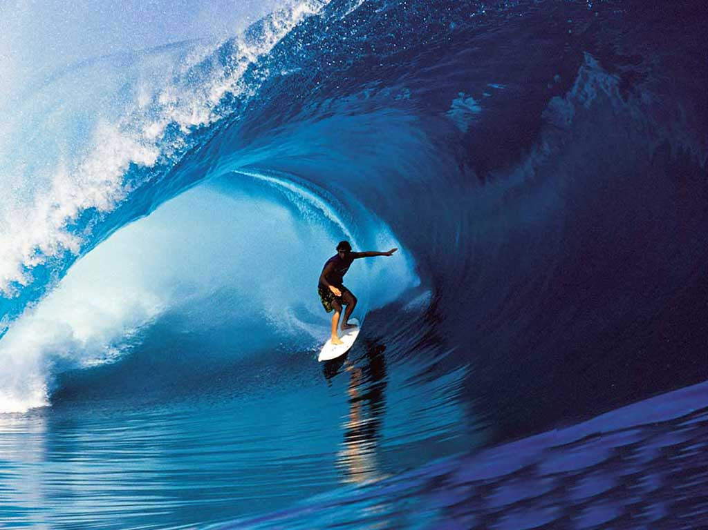
Theme 2: Give It All You’ve Got
“You never fail until you stop trying.”
~Florence Griffith Joyner
What does the phrase “give it all you’ve got” mean?
What does Florence Griffith Joyner seem to be saying about success and failure?
In what kinds of situations might a person be required to “give all”?
What examples can you name of people who tried very hard to reach a goal?

Slide 2
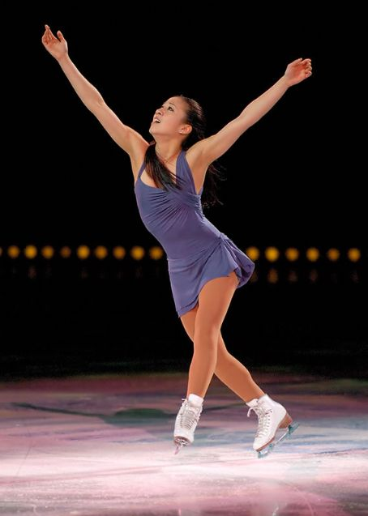
Michelle Kwan: Heart of a Champion
Author: Michelle Kwan
Genre: autobiography
Day 1
Day 2
Day 3
Day 4
Day 5

Slide 3
Day 1 Schedule
Reading
  Teacher Read Aloud
  Vocabulary
  Fact and Opinion
  Read Segment 1 (138-143)
Word work
  Pretest (157g)
Writing and Language
  Daily Language Practice
  Common and Proper Nouns
    Brief review (157k)
Back to Home Screen

Slide 4
Vocabulary
Objective: We will define vocabulary words
amateur: someone who engages in an athletic activity for fun rather than for pay.
artistic: showing skill and good taste
audience: the people gathered to see and hear a performance
compete: to take part in a contest
elements: the parts of which something is made up
judges: people who decide who wins a contest
presentation: performance
pressure: urgent or forceful demand
required: necessary
technical: having to do with technique

Slide 5
Vocabulary Activity
We will fill in vocabulary words where the best fit the context.
amateur, artistic, audience, compete, elements, judges, presentation,
pressure, required, technical
Dear Ms. Kwan,
I was in the at your last competition. I thought your
was breathtaking! If I had been one of the , I would have given you the highest score possible for interpretation. You also deserved top scores for merit, since your jumps were flawless and your spins were the best I have ever seen. Even though you must have been under extreme , you skated as if you felt calm and happy.
I am not an expert, but it seems to me that you performed all of the , so I do not understand why some of the judges failed to give you perfect scores. Sometimes it must be heartbreaking to in world-class competitions.
I hope that when you are no longer an and have become a professional skater, you will appear in many ice shows and exhibitions.
Sincerely,
Helen Horli
Back to Day 1 Schedule

Slide 6
Fact and Opinion
We will identify facts and opinions
Prior knowledge
  True or False: The sun heats the earth.
  True or False: Blue is the best color.
  One of these is a fact and one is an opinion.
Concept
  Fact: a statement which can be proven
  Opinion: what someone thinks, feels, or believes. Cannot be proven
Example
  America’s Independence Day is July 4th.
    This is a fact. How do you know?
  Dogs are better than cats.
    This is an opinion. How do you know?
Importance
  Writers of nonfiction sometimes state opinions as if they were facts. It is important for you to be able to distinguish which is being used. (2 on CST)

Slide 7
Fact and Opinion
We will identify fact and opinion
Skill:
  Read the statement
  Highlight key opinion words such as: think, should, feel, and best.
  If there are no opinion key words, ask yourself “Can this be proven?”
    If it can, it is a fact.
    If it cannot, it is an opinion.
I do
  Which of these is an opinion?
    Halley’s comet should return next in 2061.
    Halley’s comet returns about every 75 years.
    Comets are made mostly of ice, dust, and rocks.
    You’ll be thrilled by the sight of the comet.
We do
  Which of these is a fact?
    Comets cause catastrophes.
    Comets are beautiful and interesting.
    People are fascinated by comets.
    Halley’s comet last visited in 1985-1986.
You do
  Which statement is a fact?
    Native American trails seemed to wind around without reason.
    Shoveling snow was an exciting activity.
    Drivers felt frustrated about having to walk ahead of their carts.
    Ruts in a road measured one foot or more in depth.

Slide 8
Fact and Opinion
We will identify fact and opinion
Closure
  What is a fact?
  What is an opinion?
  How can you tell if a statement is a fact or opinion?
  Which of the following is an opinion?
    a) Senior skaters cannot compete at lower levels.
    b) The freeskate is longer for men than for women.
    c) I though I was ready to become a senior skater, at the age of 12.
    d) Each skater has 2 programs for competitions.
Independent Practice
  As you read fill in practice book page 64
Back to Day 1 Schedule

Slide 9
Daily Language Practice
We will proofread and correct sentences with grammar and spelling errors
The winner of the wheel chair race was from scotland.
Have you tried my homade brownies
what can we do to protect the wildelife in our parks?
Back to Day 1 Schedule

Slide 10
Day 2 Schedule
Reading
  Segment 2 (144-150)
  Fact and Opinion
    Finish practice book pg. 64
  Comprehension questions (pg. 152)
    Practice book pg. 65
  Vocabulary
    Practice book pg. 63
Word Work
  Compound Words (157e)
    Practice book pg. 68
  Spelling
    Practice book pg. 69
Writing and Language
  Daily Language Practice
  Grammar
    Practice book pg. 73
  Writing an announcement
    Practice book pg. 76
Back to Home screen

Slide 11
Compound Words
We will separate compound words into their ssmaller parts.
Prior Knowledge:
  We have used our understanding of Latin roots to help us define words (rupt, struct)
  Today we will separate compound words to help us figure out their meanings.
Concept:
  Compound word: a word made up of two smaller words
Example:
  footwork = foot + work
  Meaning: work of the feet, or foot movement
Importance:
  It is possible to figure out the meaning of a compound word by combining the meanings of the 2 smaller words. (2 on CST)

Slide 12
Compound Words
We will separate compound words into their separate parts.
Skill:
  Read the word
  Draw a line to separate the smaller words.
  Think of the meaning of each of the smaller words.
  Put the 2 meanings together to come up with the meaning of the compound word
I do
  What does extraordinary mean?
    2. extra/ordinary
    3. “extra” means more than
    “ordinary” means regular
    4. So extraordinary means “more than regular”
    What does extraordinary mean?
    Regular
    Amazing
    Imaginary
    perplexed

Slide 13
Compound Words
We will separate compound words into their separate parts.
We do:
  In the freeskate program, you get to show your artistry.
You do:
  Kwan couldn’t even think about her schoolwork.
Skill:
  Read the word
  Draw a line to separate the smaller words.
  Think of the meaning of each of the smaller words.
  Put the 2 meanings together to come up with the meaning of the compound word

Slide 14
Compound Words
We will separate compound words into their separate parts.
Closure:
  What are compound words?
  How do we define compound words?
  Doghouse
    What are the 2 smaller words?
    What is the meaning of the compound word?
    How do you know?
Independent Practice:
  Practice book pg. 68
Back to Day 2 Schedule

Slide 15
Daily Language Practice
We will proofread and correct with grammar and spelling errors.
The scientists tried to track the wolfs in the daytim.
Our schools computer equipment is very up to-date.
The soccer field is ten foots from the hiway.
Back to Day 2 Schedule

Slide 16
Writing an Announcement
We will use the characteristics of an announcement to write one of our own.
Prior knowledge
  Tell you partner about an important event that is coming up
  The written version of this is an announcement.
Concept
  Announcement: a short speech or notice of important information about an event. It may be written, spoken, broadcast live, or recorded on tape.
Example
  Every day we meet on the blacktop for morning announcements, important events that we need to know about.

Slide 17
Writing an Announcement
We will use the characteristics of an announcement to write one of our own.
Skill:
  State the purpose of the announcement at the very beginning.
  Answer questions what, who, when, where, why, how, and how much.
  Use clear, interesting, and friendly language that the audience will understand.

Slide 18
Writing an Announcement
We will use the characteristics of an announcement to write one of our own.
Event:
Date:
Time:
Place:
Cost:
Details about the event:
Skill:
  Answer questions what, who, when, where, why, how, and how much.
  State the purpose of the announcement at the very beginning.
  Use clear, interesting, and friendly language that the audience will understand.

Slide 19
Writing an Announcement
We will use the characteristics of an announcement to write one of our own.
Closure:
  What is an announcement?
  What information should be included in an announcement?
Independent practice:
  Use practice book pg. 76 to plan your announcement
  Write a short announcement
Back to Day 2 Schedule

Slide 20
Day 3 Schedule
Reading
  Partner Read
  Fact and Opinion
    Practice book pg. 66, 67
Word work
  Spelling
    Practice book pg. 70
Writing and Language
  Daily Language Practice
  Singular and Plural Possessive Nouns
    Brief review (157k)
    Practice book pg. 74
Back to Home Screen

Slide 21
Daily Language Practice
We will proofread and correct sentences with spelling and grammar errors
We go to Jeffs house every weekkend.
Who is on your baskitball team!
Back to Day 3 Schedule

Slide 22
Singular and Plural Possessive Nouns
Review
Singular Possessive: add an apostrophe and s (‘s) | Plural possessive: add an apostrophe if the noun ends with s (‘). Otherwise, add and apostrophe and s (‘s)
Sort the following words into the appropriate category: the parrot’s cage, the
women’s violin, Brian Boitano’s heart, the coaches’ conference.
Practice book pg. 74 Back to Day 3 Schedule

Slide 23
Day 4 Schedule
Reading
  Listen to story
  “The Eleven Cities Tour” (154-157)
Word Work
  Spelling
    Practice book pg. 71
  Word Families (157i)
    Practice book pg. 72)
Writing and Language
  Daily Language Practice
  Ordering Important Information
Back to Home Screen

Slide 24
Daily Language Practice
We will proofread and correct sentences with spelling and grammar errors.
Every body wanted to pet the horse but they were afraid it would bite.
the newzcast took place in Los Angeles.
Back to Day 4 Schedule

Slide 25
Ordering Important Information
We will use sequence words to reorder information
Concept
  Sequence words: words which show the order in which events happen
Importance
  Information in announcements needs to be presented in a clear order, so that attention is drawn to the important information.
Skill
  Read the announcement
  Highlight sequence words (first, next, last, after, etc)
  Write numbers next to the sentences in the order they should go.
  Rewrite the announcement in the proper order.

Slide 26
Ordering Important Information
We will use sequence words to reorder information
Practice book pg. 77
After the match, a victory party will be held in the cafeteria. Game time is 3 P.M.. Following the pep rally, the Bloomington Wildcats will play against the Forest Lane Eagles for the regional championship at O’neill Field. During the rally, Coach Strauss will introduce all of the players and hand out free T-shirts and banners. There will be a pre-game pep rally tomorrow at 2:20 in the gym before the most important soccer match of the season. Go Wildcats!
Skill
  Read the announcement
  Highlight sequence words (first, next, last, after, etc)
  Write numbers next to the sentences in the order they should go
Back to Day 4 Schedule

Slide 27
Day 5 Schedule
Reading
  Comprehension Test
  Vocabulary Test
Word Work
  Spelling Test
Writing and Language
  Possessive Phrases
    Practice Book pg. 75
Back to Home Screen

