Slide 1
Voices of the Revolution
“We always had governed ourselves, and we always meant to.” ~farmer at Battle of Lexington, April 1775
“The flame is kindled and like lightning it catches from Soul to Soul.” ~Abigail Adams
“I know not what course others may take, but as for me, give me liberty or give me death!” ~Patrick Henry
What important idea do all three quotations seem to be talking about?
What effect do you think each quotation would have had on American colonists who read or heard it at the time of the Revolutionary War?
What do you think the flame in Abigail Adams’ quotation symbolizes?

Slide 2
And Then What Happened, Paul Revere?
Author: Jean Fritz
Illustrator: Margot Tomes
Genre: Biography ~ a nonfiction selection based on Paul Revere’s life.

Slide 3
Daily Schedules
Day 1
Day 2
Day 3
Day 4
Day 5

Slide 4
Day 1 Schedule
Reading
Vocabulary
Author’s Viewpoint
Read Segment 1 (262-270)
Word Work
Pretest (285g)
Writing and Language
Daily Language Practice
Subject-Verb Agreement Review (285k; optional)
Back to Paul Revere

Slide 5
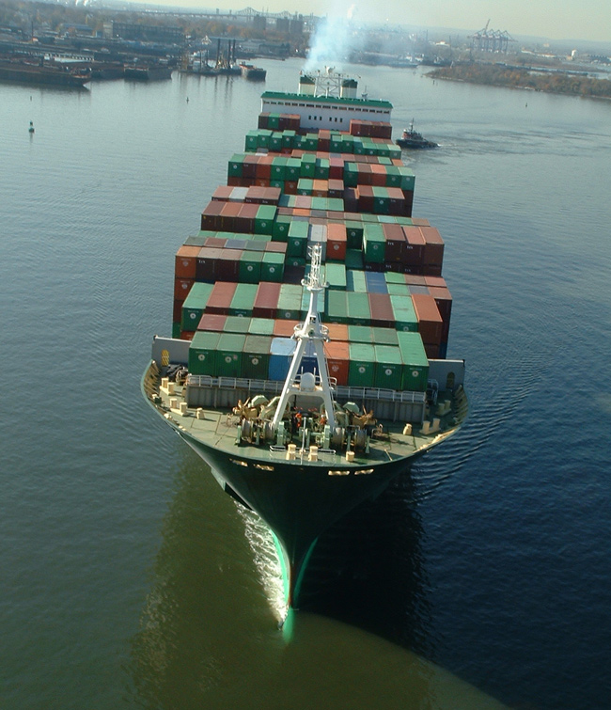
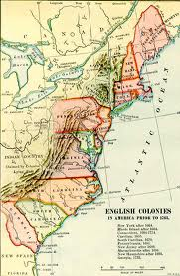
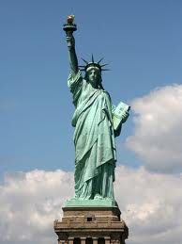
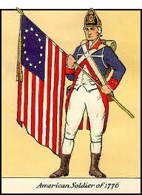
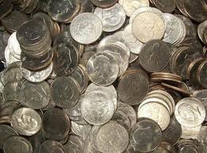
Vocabulary
cargo: the freight carried by a vehicle
colonies: territories governed by a parent country; the name for the 13 territories that became the original United States.
express: fast, direct, and often nonstop
liberty: the right to act as one chooses; freedom from the control of others
oppose: to act against something or someone
Patriot: a person who loves and defends his or her country; a colonist who was against British rule in the time of the Revolutionary War
revolutionary: of or tending to promote radical political or social change
sentries: soldiers who stand at watch for danger or for people without permission to pass
taxes: fees for the support of government required to be paid by people and businesses

Slide 6
Vocabulary Practice: We will use vocabulary words where they best fit the context.
Fellow People of New England:
Please come tonight at 8 P.M. to a very important meeting. As you well know, our is being threatened by the British government.
Just today, we learned of new to be collected on tea.
This is just the latest example of how King George III controls our lives through the arriving in Boston harbor each day.
We the people of the must unite to fight against these wrongs.
Each must show his or her willingness to defend the rights of Americans.
If you the King’s actions, join us tonight so we can plan how to fight back.
Tonight we may call for the to begin!
Whatever we decide, our plan will be spread throughout the colonies by riders on the fastest horses available.
Please note that will stand guard outside the meeting to warn us if British soldiers come near the meeting hall.
cargo
colonies
express
liberty
oppose
Patriot
revolution
sentries
taxes
Back to Day 1 Schedule

Slide 7
Author’s Viewpoint We will identify the author’s viewpoint.
Prior Knowledge
Concept
Share with your partner how you feel about soccer.
This is your viewpoint on the subject of soccer.
Not everyone has the same viewpoint on soccer.
Viewpoint: how one feels about a topic, or one’s thoughts on a topic.
Importance
Identifying the author’s viewpoint helps a reader understand why the author is interested in the subject and how the author thinks.

Slide 8
Skill
Read the last paragraph on page 263.
The author is giving her opinion that Paul Revere is one of the busiest people in Boston.
The language she uses –the way she repeats the word more- makes me think she really admires his busy life.
I think her purpose for writing this book is both to entertain and to inform the reader.
From all these clues I think that her viewpoint about Paul Revere is that she admires him.
Think about the facts and opinions in the selection.
What type of language does the author use? (positive or negative)
What is the author’s purpose: to entertain, to inform, or to explain?
Combine the evidence from the text with your own knowledge to make an inference about the author’s viewpoint

Slide 9
Skill
We do: Read the first paragraph on page 264 (open practice books to page 140)
What opinion can you find?
“In Boston there was always plenty to see”
Is the language positive or negative?
Positive
What is the author’s purpose?
To entertain and to inform
What viewpoint is revealed?
The author seems to think Boston was a very interesting place to be.
Think about the facts and opinions in the selection.
What type of language does the author use? (positive or negative)
What is the author’s purpose: to entertain, to inform, or to explain?
Combine the evidence from the text with your own knowledge to make an inference about the author’s viewpoint

Slide 10
Author’s Viewpoint
Closure
Practice
What word means, “how one feels about a topic”?
What 3 things do we look at to identify the author’s viewpoint?
Read the last paragraph on page 142 of your practice book. What is the author’s viewpoint on Benedict Arnold?
Guided Practice
As we read, we will continue filling in the chart on practice book pg. 140
Independent Practice
Later in the week, we will complete practice book pages 142-143
Back to Day 1 Schedule

Slide 11
Daily Language Practice We will proofread and correct sentences with spelling and grammar errors.
Daves dream is to become an acter.
Is the dog barking at a bergler
There was thunnder and lightning in washington today.
Back to Day 1 Schedule

Slide 12
Day 2 Schedule
Reading
Segment 2 (271-278)
Author’s Viewpoint
Practice book pg. 140
Comprehension questions (280)
Practice book pg. 141
Vocabulary
Practice book pg. 139
Word Work
Possessives and Contractions
Spelling
Practice book pg. 145
Writing and Language
Daily Language Practice
Grammar
Practice book pg. 149
Back to Daily Schedules

Slide 13
Possessives and Contractions Objective: We will identify and interpret possessives and contractions
Concept
Importance
Apostrophe ( ‘ ): a symbol that takes the place of letters in a contraction; it can also be used to show possession.
Possessive (‘s or s’): indicates ownership
Paul Revere’s horse = the horse belonging to Paul Revere
Contraction: two words put together in which letters have been left out
He is = he’s
Identifying when a contraction or possessive is being used will increase your reading comprehension.

Slide 14
Skill
I do:
a man’s pet squirrel
Is the apostrophe replacing letters?
No
Is there a noun immediately following the word with the apostrophe?
Yes
It is a possessive meaning the pet squirrel belongs to the man
they’d like to get back
Is the apostrophe replacing letters?
Yes
It is a contraction for they would
Highlight the apostrophe and the letters following it.
Is the apostrophe replacing missing letters?
It is a contraction
Is there a noun immediately following the word with the apostrophe?
It is a possessive

Slide 15
Skill
We do:
that’s what he did
Is the apostrophe replacing letters? Yes
It is a contraction for that is
printer’s colors
Is the apostrophe replacing letters? No
Is there a noun immediately following the apostrophe word? Yes
It is a possessive meaning the colors belonging to the printer
Highlight the apostrophe and the letters following it.
Is the apostrophe replacing missing letters?
It is a contraction
Is there a noun immediately following the word with the apostrophe?
It is a possessive

Slide 16
Skill
You do:
Paul’s spurs
Possessive meaning the spurs belonging to Paul
this wasn’t enough
Contraction meaning was not
Highlight the apostrophe and the letters following it.
Is the apostrophe replacing missing letters?
It is a contraction
Is there a noun immediately following the word with the apostrophe?
It is a possessive

Slide 17
Closure
What word means, “a symbol which shows possession”?
What word means, “belonging to”?
Is Revere’s dog a possessive or a contraction?
How do you know?
What does it mean?
Independent Practice
Practice book pg. 144
Back to Day 2 Schedule

Slide 18
Daily Language Practice
She need a mirrore to check her contact lenses.
the mayer declared today a holiday.
Suzy and Li climbs on the trackter.
Back to Day 2 Schedule

Slide 19
Day 3 Schedule
Reading
Partner Read
Author’s Viewpoint
Practice book pg. 142-143
Word Work
Greek root anti
Spelling
Practice book pg. 146
Writing and Language
Daily Language Practice
Writing a Character Sketch
Back to Daily Schedule

Slide 20
Greek Root anti objective: we will analyze the meaning of anti, and generate a list of words with this root.
Concept
Importance
Anti: a Greek root meaning “against, or opposed to”
Example:
The doctor gave me an antibiotic to help fight off my infection.
Antibiotic means “against harmful organisms”
Recognizing word roots can help you figure out the meaning of words you do not recognize.

Slide 21
Greek Root anti
Skill
Practice
Highlight the word root.
Look at the remainder of the word
What does it mean
Use context clues to help define the word.
I do
The end of the story was anticlimactic, it really let me down.
We do
Andy is very antisocial, he is always hanging out by himself.
You do
I put antifreeze in my car’s battery to help it start in the morning.

Slide 22
Closure
What root means “against or opposed to”?
How do we determine the meaning of a word containing a Greek/Latin root?
Which word means “against poison”?
antitrust
antitoxin
Independent Practice
What other words can you think of containing anti?
What do each of these words mean?
Back to Day 3 Schedule

Slide 23
Daily Language Practice
My brothers job is to hang the bannar.
The goats eats clovor all summer.
Back to Day 3 Schedule

Slide 24
Writing a Character Sketch We will write a character sketch.
Prior Knowledge
Concept
Tell your partner about your best friend.
If you were to write this description, it would be called a character sketch.
Character sketch: a written profile that gives a colorful and vivid picture of what a real person or character is like.
Example: the author of “And Then What Happened, Paul Revere?” wove many colorful and interesting details about Paul Revere’s character, life, family, daily activities, and heroic actions.

Slide 25
Skill
Choose a real person or a story character to write about.
Brainstorm details about how the person looks, acts, thinks, and feels.
Open with a quote or an anecdote (short story) about the character.
Write a sentence that sums up the person’s most significant character traits.
Include several details that support your summary of the person’s traits.
End with a conclusion that sums up the person’s significant traits.

Slide 26
Conclusion
What do you call a piece of writing that gives a picture of what a real person or story character is like?
What type of information should be included in a character sketch?
Independent practice:
Use practice book pg. 152 to brainstorm your character.
Write a 1-2 paragraph character sketch
Back to Day 3 Schedule

Slide 27
Day 4 Schedule
Reading
“Yankee Doodle” (282-285)
Word Work
Spelling
Practice book pg. 147
Synonyms
Writing and Language
Daily Language Practice
Grammar
Practice book pg. 150
Back to Daily Schedules

Slide 28
Synonyms We will identify synonyms.
Activate Prior Knowledge
Concept
What is another word for happy?
When you think of words that mean nearly the same thing, you are identifying synonyms.
Synonyms: words with the same, or nearly the same, meaning.
Importance: Writers often use synonyms to avoid repeating words, and to keep their writing fresh and interesting.

Slide 29
Skill
I do
Instead he patrolled the streets at night, delivered his messages to Philadelphia, and kept himself ready at all times.
Patrolled: watched
Delivered: carried
Ready: prepared
We do
He felt uneasy to be on a moonlit road on foot.
Uneasy: nervous, scared
Road: path, trail
You do
Sometimes he was in such a hurry that his writing looked sloppy.
Hurry: rush
Sloppy: messy
Use context clues to determine the meaning of the word.
Think of other words that have the same, or nearly the same, meaning.

Slide 30
Closure
What do we call two words that are similar in meaning?
How do we identify synonyms for a given word?
What is a synonym for the underlined word?
Paul found that money could be made in many ways.
arrived
dragged
earned
discovered
Back to Day 4 Schedule

Slide 31
Daily Language Practice
We each found a quarter under our desks?
What is the mater with ethan today?
Back to Day 4 Schedule

Slide 32
Day 5 Schedule
Reading
Comprehension Test
Vocabulary Test
Word Work
Spelling Test
Writing and Language
Practice book pg. 151
Back to Daily Schedules

