Slide 1
Pioneer Girl
Author: Andrea Warren
Genre: nonfiction ~ the true story of the McCance family homesteaders.
Day 1
Day 2
Day 3
Day 4
Day 5

Slide 2
Day 1
Reading
Vocabulary
Read Segment 1 (499-507)
Word Work
Spelling pretest (519g)
Writing and Language
Daily Language Practice
Possessive Pronouns
Back to Pioneer Girl

Slide 3
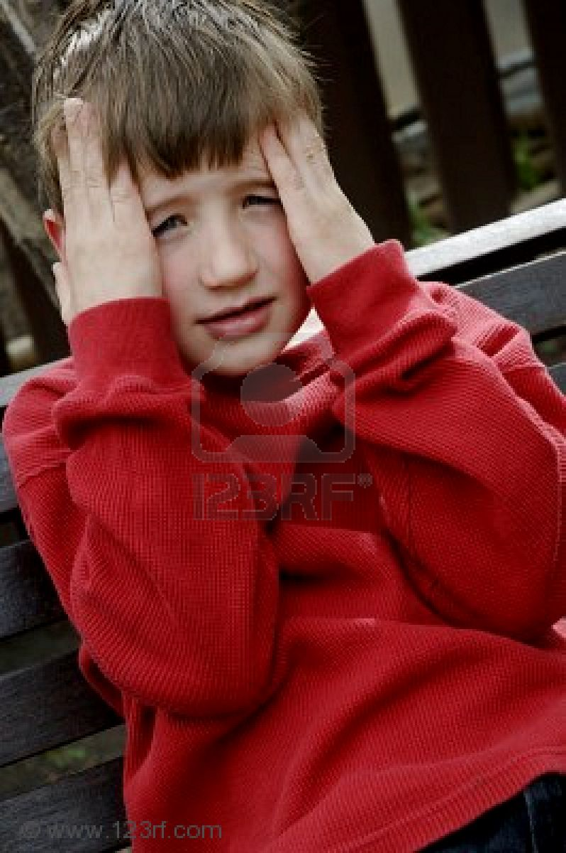
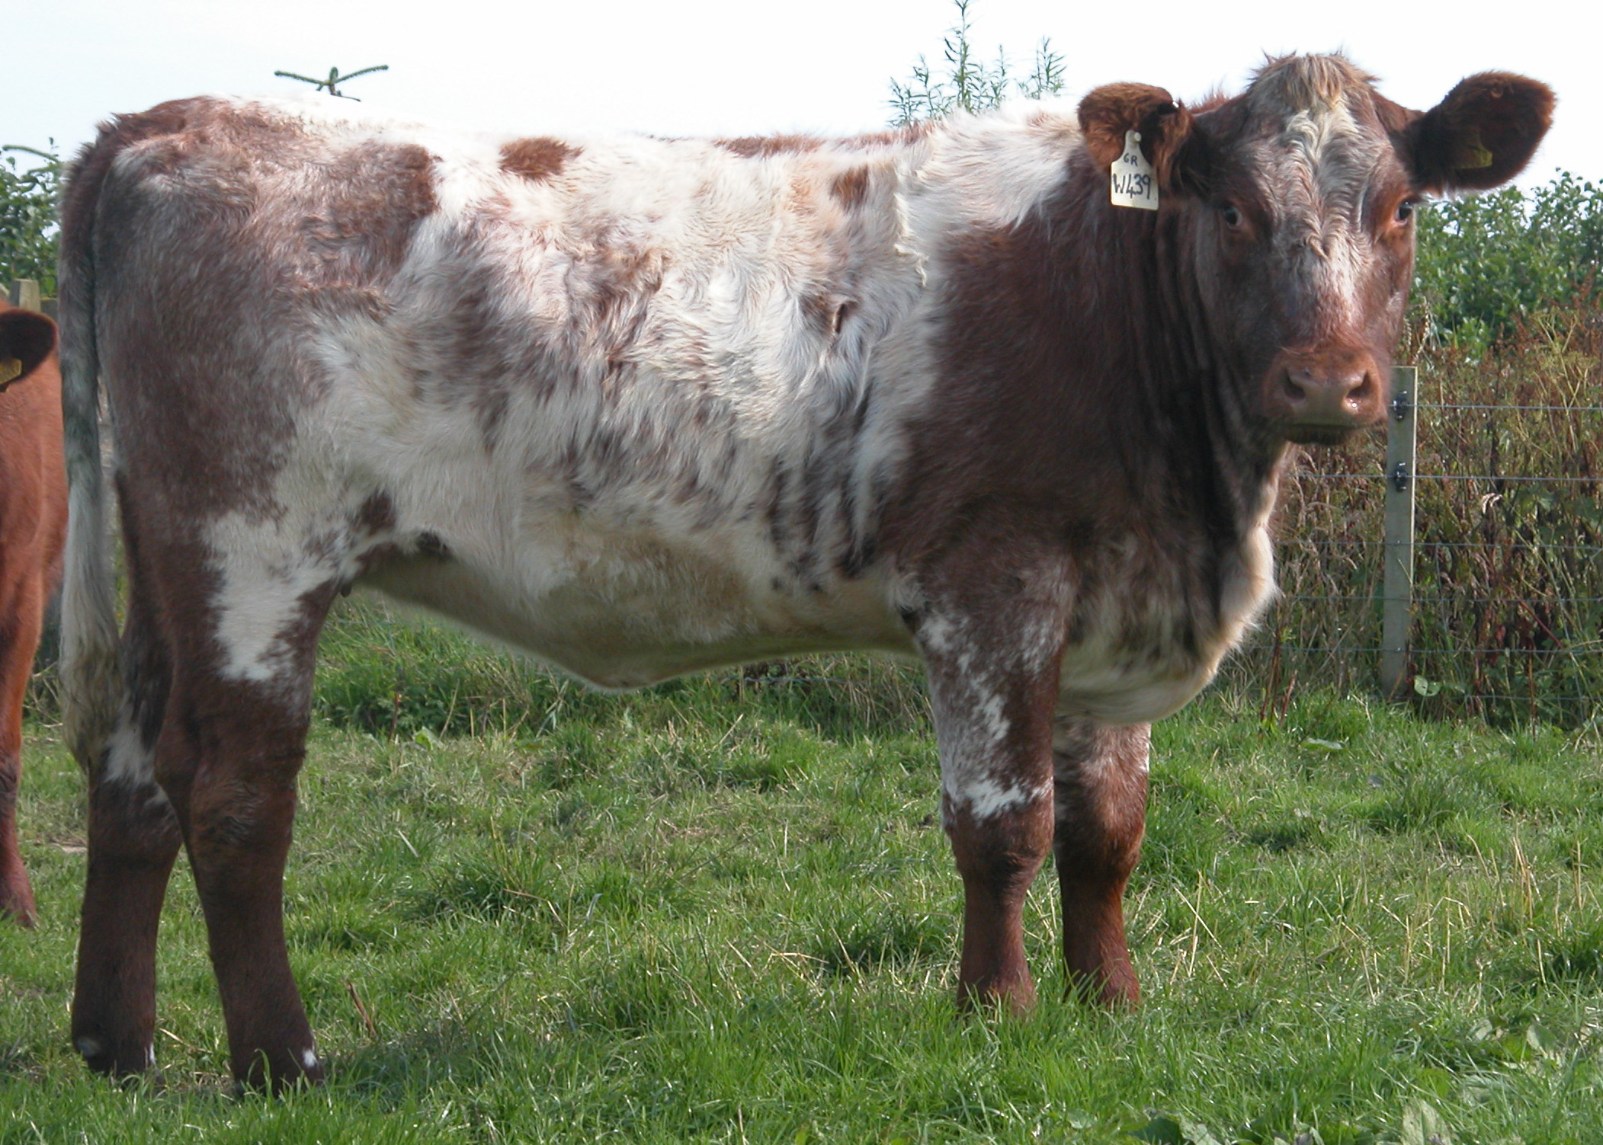
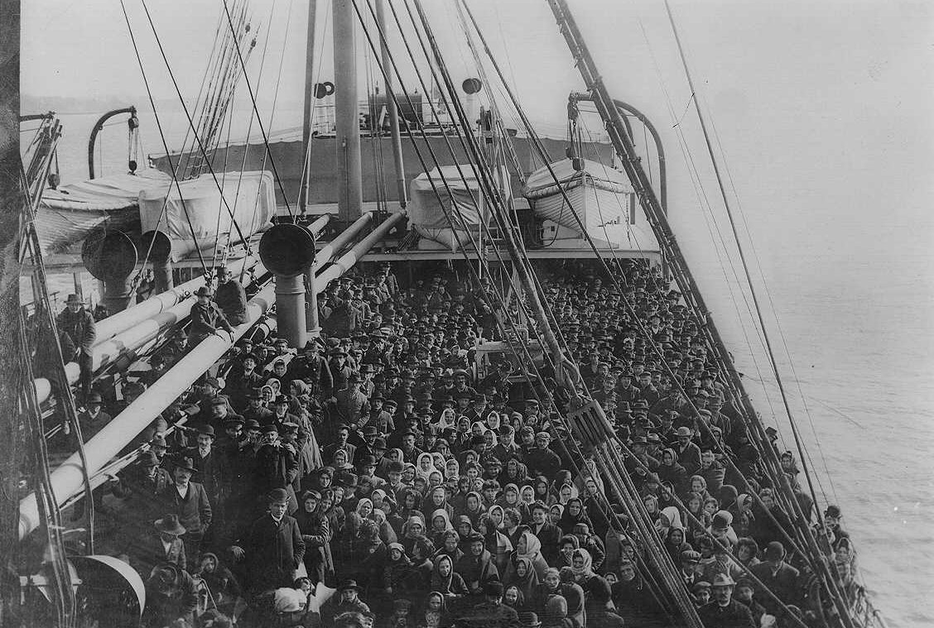
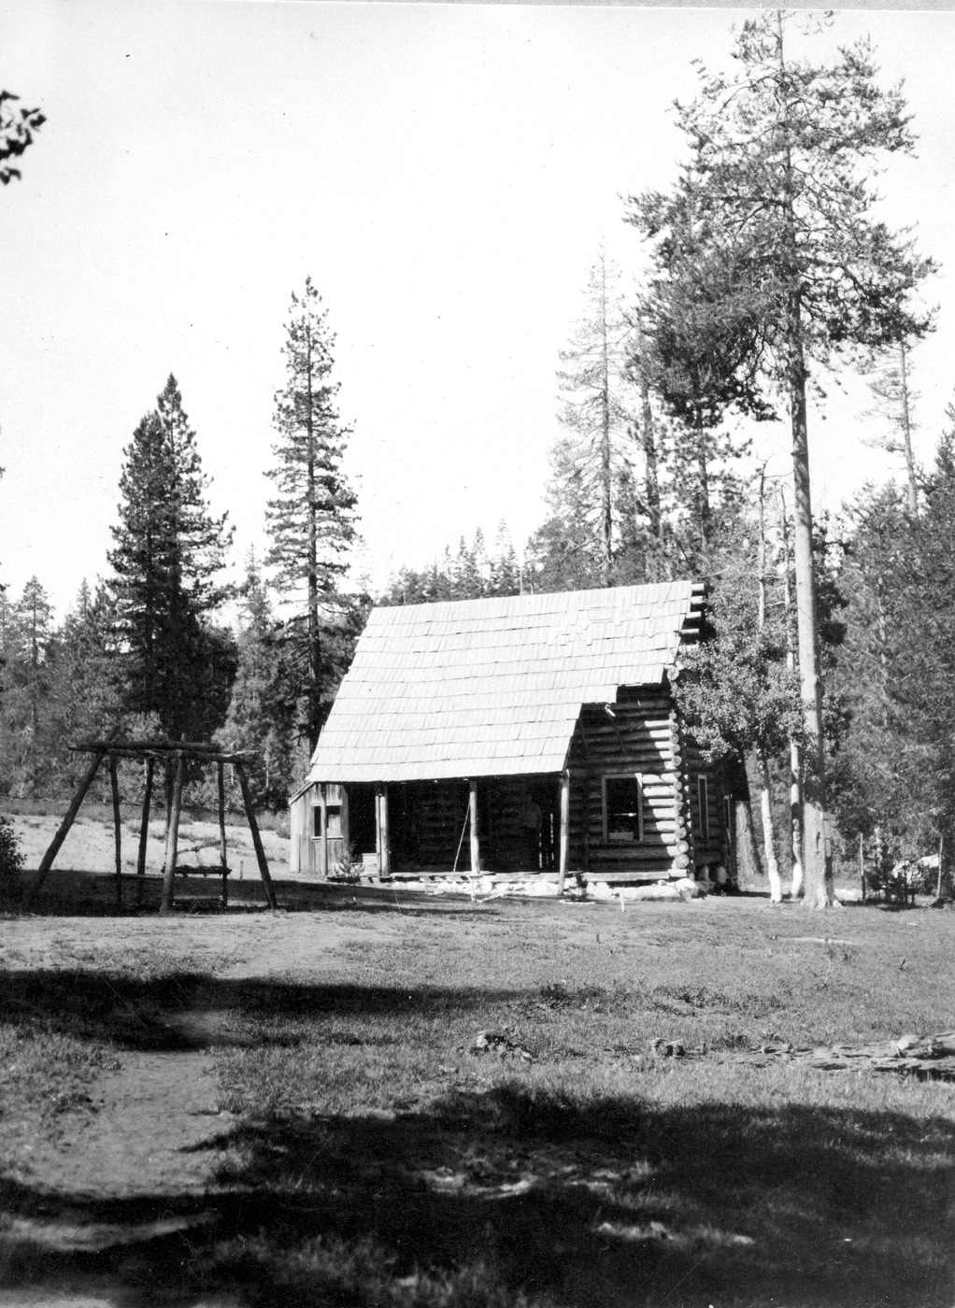
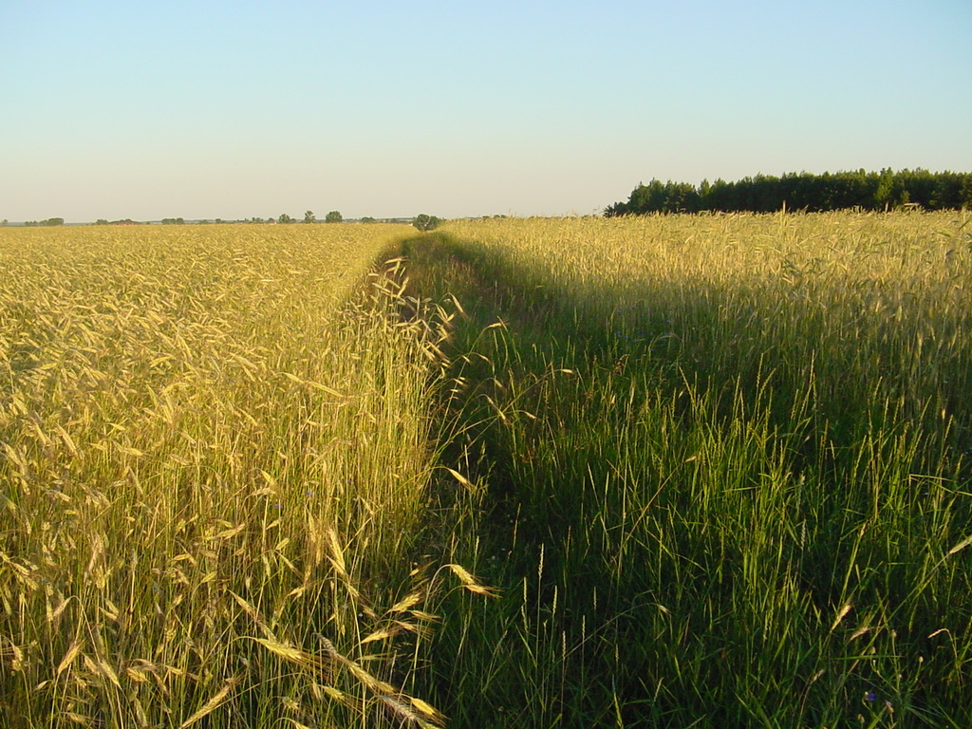
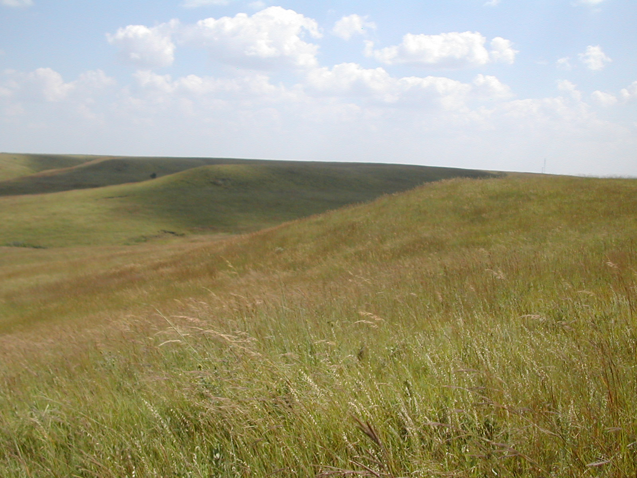
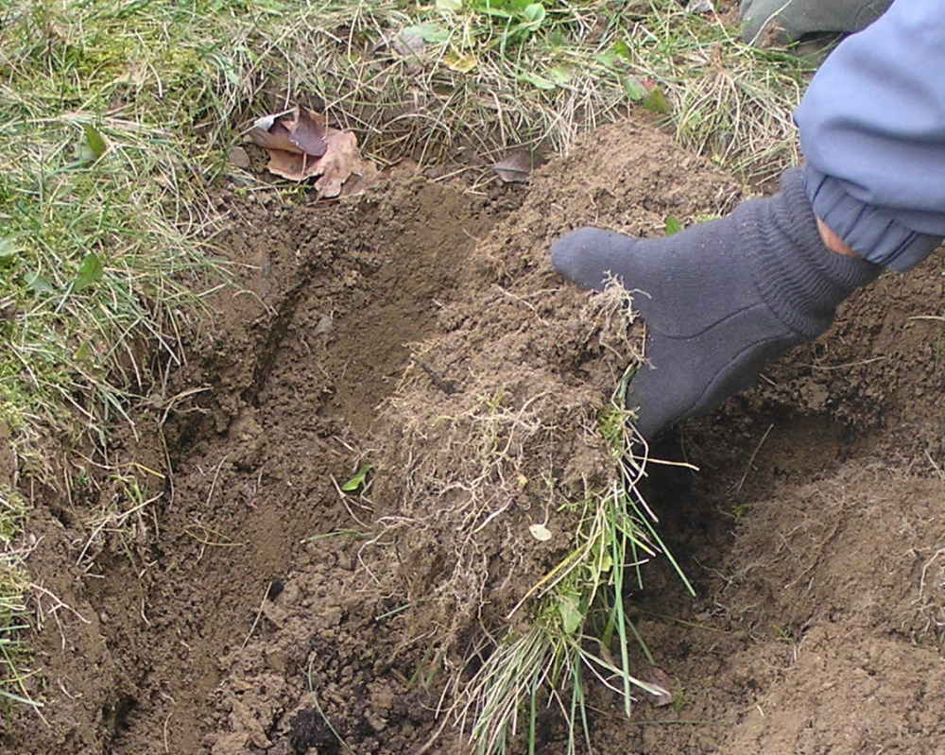
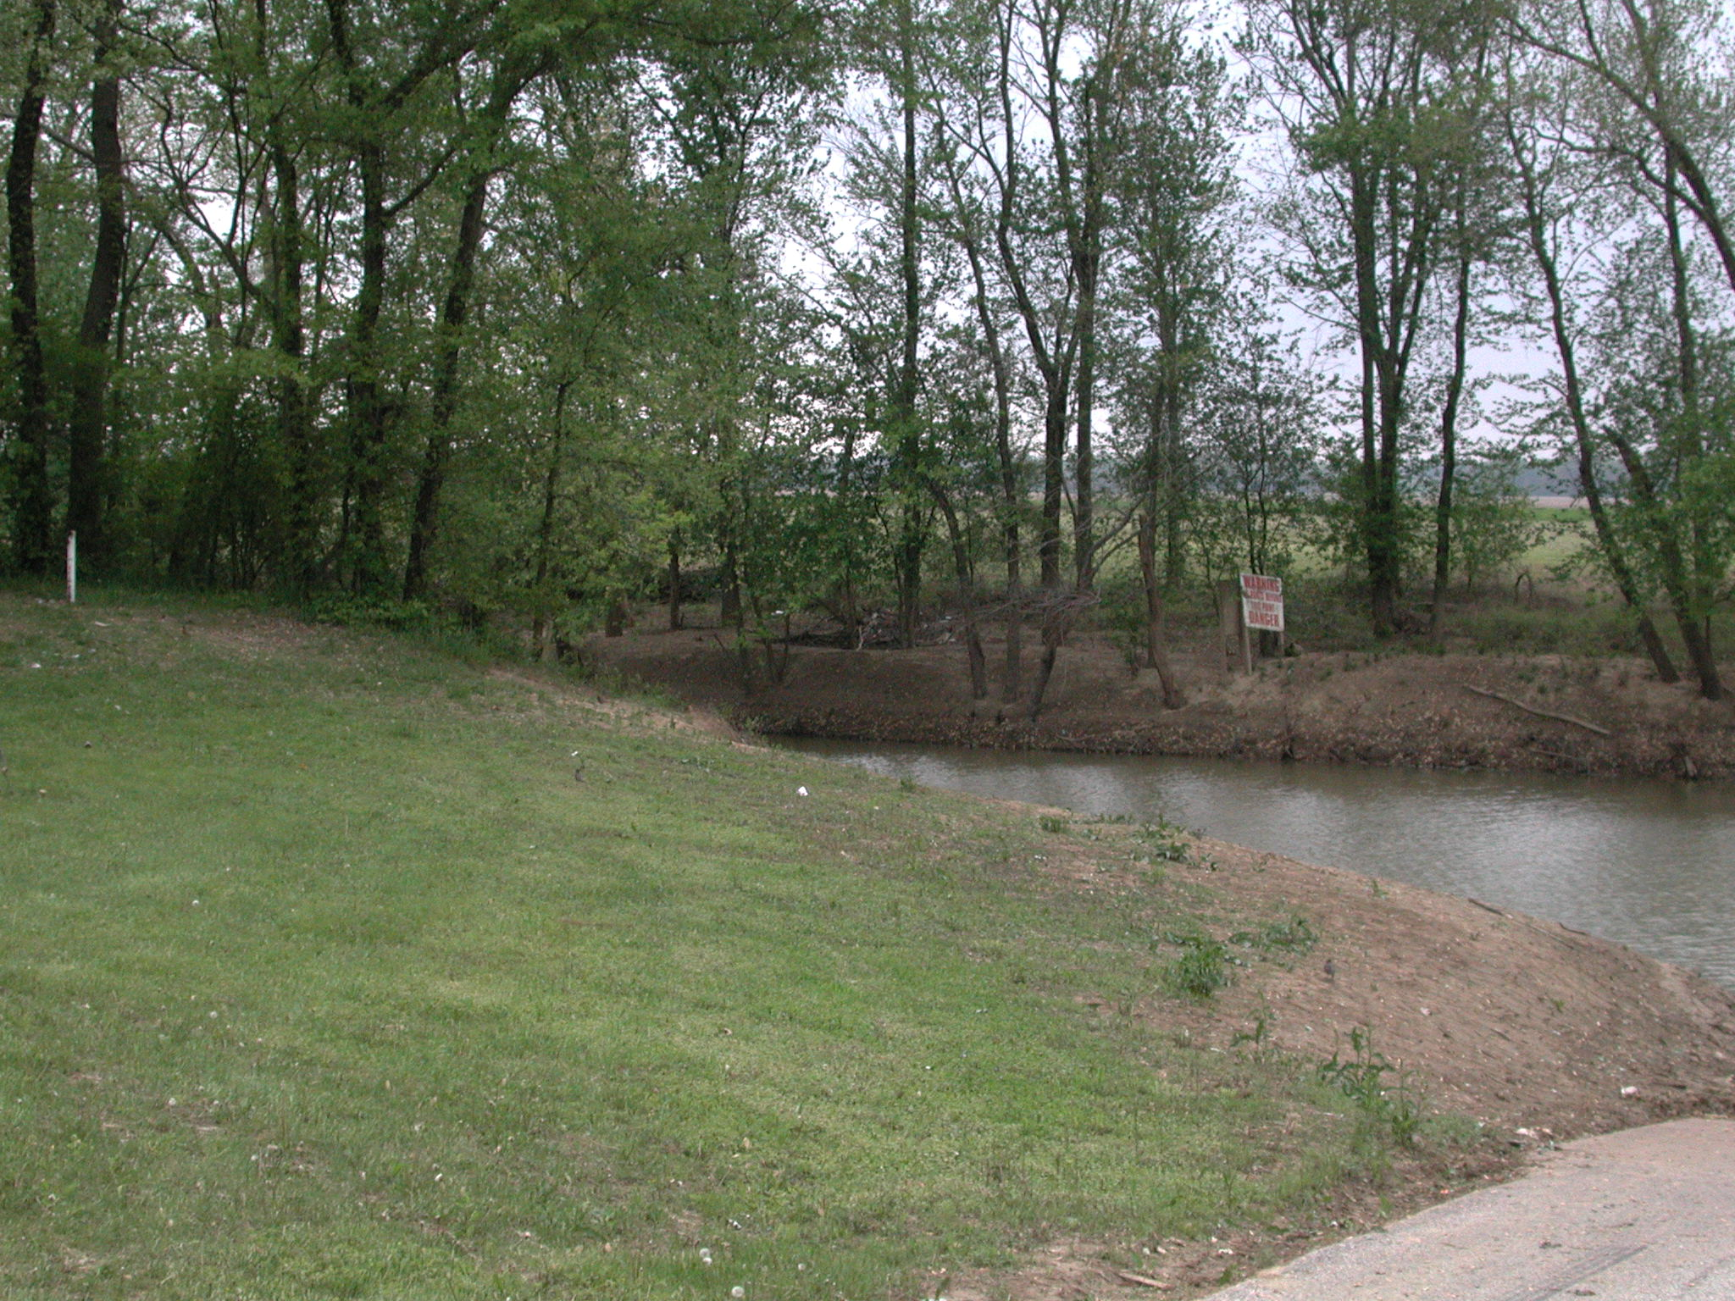
Vocabulary
heifer: a young cow
homestead: a farmhouse, its buildings, and the land it sits on
immigrants: people who leave their native country to settle in another country
prairie: a large area of flat or rolling grassland
sod: a chunk of grassy soil held together by matted roots
Objective: We will define new vocabulary words.
claim: a piece of land claimed by a settler
convinced: caused to believe
discouraged: in low spirits and without hope
fertile: rich in material needed to grow healthy plants

Slide 4
Objective: We will insert words where they best fit the context
A Better Life Awaits You on the Western Plains!
Is your farm barely keeping the family fed?
Is each cow thin and gaunt, and each mooing with hunger?
Have you become by small harvests year after year?
It’s time to make a move to the incredibly Great Plains. Crops grow so well there that you’ll barely be able to harvest them before it’s time to plant again. You can choose a and establish a , and in just five short years the land will be yours forever! The lush grasses of the will fatten your cattle and will also provide you with walls for a cozy house of . These glorious lands are open to all – citizens and alike. If you aren’t quite that you should make this move, catch the next train west and see for yourself. You’ll become a pioneer the moment you pick up a handful of the rich dark soil!
claim
convinced
discouraged
fertile
heifer
homestead
immigrants
prairie
sod
Back to Day 1

Slide 5
Daily Language Practice
“Will you give Jon this mesage? asked Tarik.
This is the tougher carot I ever chewed.
“I am ashamed to admitt that I forgot your book again” said Franny.
Back to Day 1

Slide 6
Possessive Pronouns
Objective: we will identify and use possessive pronouns (ELC 1.2)
Concept
Prior Knowledge
The girl’s chores occupied her all morning.
Her chores occupied her all morning.
What is the difference between these two sentences?
possessive pronoun: a word that replaces a noun and shows ownership

Slide 7
Possessive Pronouns
Skill
I do
My, your, his, her, its, our, and their appear before nouns that are subjects.
Your dog is whining.
Mine, ours, his, hers, its, ours, and theirs stand alone and replace nouns in sentences.
The cat down the street is theirs.
The boy’s mule refused to move.
“boy” is before the noun, so we will use the pronoun “His”
We do
The pioneers’ dreams gave them courage.
Does the noun we are replacing come before a noun?
What pronoun should we use?

Slide 8
Possessive Pronouns
You do
Closure
The woman’s dress was faded and worn.
The book is Jane’s.
The dress’s buttons no longer matched.
What do we call pronouns that show ownership?
Jim’s and my presentations were about settlers in western Kansas.
Is this Mike and Sam’s?
Independent Practice
Practice book pg. 303
Back to Day 1

Slide 9
Day 2
Reading
Segment 2 (508-513)
Comprehension Questions (514)
Practice book pg. 295
Vocabulary
Practice book pg. 293
Word Work
Spelling
Practice book pg. 299
Writing and Language
Daily Language Practice
Back to Pioneer Girl

Slide 10
Daily Language Practice
According to the restaurant review, the new ice cream show has the most worst servis.
The first part of theirs ocean voyege was very calm.
Back to Day 2 Schedule

Slide 11
Day 3
Reading
Partner read
Propaganda
Word Work
Spelling
Practice book pg. 300
Writing and Language
Daily Language Practice
Contractions with Pronouns
Back to Pioneer Girl

Slide 12
Propaganda
Objective: we will identify the persuasive techniques used in propaganda
Importance
Writers and speakers often try to persuade other to think or act a certain way.
It is important to determine whether you should believe what an author is saying.
Prior Knowledge
Turn to page 500 in your textbook. Let’s read the poster together.
What is the poster trying to make people do?

Slide 13
Propaganda
Concept
Propaganda: an effort to make people believe a certain opinion or act a certain way
Overgeneralization: making general statements based on a few or no facts
Testimonial: using a celebrity or an expert to support a product
Faulty cause and effect: suggesting or promising, for example, that consumers will be happier simply as a result of using the product
Bandwagon: persuading consumers to do something because “everyone else” is doing it
Flattery: making customers feel “smart” for using a product
Transfer: associating a person with a product so that consumers will transfer their admiration for the person to the product

Slide 14
Propaganda
Skill
I do
Think about whether the author is trying to present an accurate picture, or a picture that only includes ideas that will persuade people to do what the author wants.
Does the author support the argument with facts?
Use the concept definitions to determine what type of propaganda is being used.
An ad in the Kansas City paper says, “Come to California. Everyone in the country is going west-don’t miss this golden opportunity.”
The ad says “everyone” is going west.
There are no facts to support the claim.
This is a bandwagon appeal

Slide 15
Propaganda
Skill
We do
Think about whether the author is trying to present an accurate picture, or a picture that only includes ideas that will persuade people to do what the author wants.
Does the author support the argument with facts?
Use the concept definitions to determine what type of propaganda is being used.
“I only travel in a Way West wagon,” says Captain John Anderson. “They’re the best wagons money can buy.”
Are there any facts supporting the claim?
Who is supporting the claim?
What type of technique uses a celebrity or expert to support the product?

Slide 16
Propaganda
Skill
You do
Think about whether the author is trying to present an accurate picture, or a picture that only includes ideas that will persuade people to do what the author wants.
Does the author support the argument with facts?
Use the concept definitions to determine what type of propaganda is being used.
Everybody who traveled on the Santa Fe Trail enjoyed the trip. We have read the diaries of fifteen people who said it was an easy journey.
Are there any facts supporting the claim?
How many people did they talk to?
What type of technique is based on few or no facts?

Slide 17
Propaganda
Closure
Independent Practice
What type of writing tries to convince people to believe or act a certain way?
Banish your blues once and for all by moving to the West, where true happiness awaits you.
Are there any facts supporting the claim?
What is supposed to make everyone happy?
What technique is being used?
Practice book page 296, 297
Back to Day 3 Schedule

Slide 18
Daily Language Practice
The farther distense I have hiked is two miles.
Lets sign up for the sports pregram.
Uncle Arnold is mine favorite rellative.
Back to Day 3 Schedule

Slide 19
Contractions with Pronouns
Objective
Concept
We will combine pronouns and verbs to form contractions
Contraction: a shortened form of two words
Skill
1. You can combine pronouns with the verbs am, is, are, will, would, have, has, and had to form contractions
2. Use an apostrophe in place of the dropped letter or letters.

Slide 20
Contractions with Pronouns
Skill
I do
1. You can combine pronouns with the verbs am, is, are, will, would, have, has, and had to form contractions
2. Use an apostrophe in place of the dropped letter or letters.
She is ready to weed the garden.
We can combine “she is” by dropping the i and adding an apostrophe
She’s ready to weed the garden.

Slide 21
Contractions with Pronouns
We do
Closure
He will weed tomorrow.
What letters will we drop out to make the contraction?
Show the contraction on your whiteboards.
You do
We are going to make taffy this afternoon.
I would like to make taffy.
She had been in charge of cleaning the pots.
What do we add in place of letters in a contraction?
Create contractions in the following sentences:
We have coated the pans with hardened sugar.
She has purchased soap.
It will make clean-up a snap.
Independent Practice
Practice book pg. 304
Back to Day 3 Schedule

Slide 22
Day 4 Schedule
Reading
“Nicodemus Stakes a Claim in History” (516-519)
Word Work
Spelling
Practice book pg. 301
Dictionary: Suffixes
Writing and Language
Daily Language Practice
Back to Pioneer Girl

Slide 23
Dictionary Suffixes
Objective
Concept
We will use suffix definitions to determine the meaning of words.
Importance: knowing the meaning of suffixes can help us determine the meaning of unknown words.
Suffix: a word part added to the end of a base word
-ness: state, condition, or quality
-ful: full of, or characterized by
-less: without
-ly: in a specified manner, or have the characteristics of
-ment: act, action, or process, or state of being acted upon
-ion: action or process, or results of an action of process

Slide 24
Dictionary Suffixes
Skill
I do
Circle the base word and determine its meaning.
Underline the suffix
Combine its meaning with the meaning of the base word.
Context clues can also be used to help determine the meaning.
The darkness, black and thick as velvet, was ripped apart by a terrible blue flash of lightning.
What is the meaning of “dark”?
What is the meaning of the suffix –ness?
So “darkness” means the condition of being without light.

Slide 25
Dictionary Suffixes
Skill
We do
Circle the base word and determine its meaning.
Underline the suffix
Combine its meaning with the meaning of the base word.
Context clues can also be used to help determine the meaning.
She was suddenly face-to-face with the long-nosed, ornery heifer.
What is the meaning of “sudden”?
What is the meaning of the suffix –ly?
What does suddenly mean?
In a way that is sudden

Slide 26
Dictionary suffixes
You do
Closure
The treeless expanse of land left the pioneers breathless.
The students were beside themselves with excitement when they learned they would be going on a trip to Sacramento.
How do we determine the meaning of words with suffixes?
What is the meaning of the following words:
kindness
merciful
cheerful
Independent Practice
Practice book pg. 302
Back to Day 4 Schedule

Slide 27
Daily Language Practice
When you are trying to learn a new langwedge, its easy to get discouraged.
Did you notis how tall Nat has grown?” asked Jenn.
Back to Day 4 Schedule

Slide 28
Day 5
Reading
Comprehension Test
Vocabulary Test
Word Work
Spelling Test
Writing and Language
Using its and it’s (519L)
Practice book pg. 305
Back to Pioneer Girl

