Slide 1
Mae Jemison: Space Scientist
Author: Gail Sakurai
Genre: Biography ~ a nonfiction selection describing the life of Mae Jemison
Day 1
Day 2
Day 3
Day 4
Day 5

Slide 2
Day 1 Schedule
Reading
Vocabulary
Main Idea
Read segment 1 (210-215)
Word Work
Pretest (229g)
Writing and Language
Daily Language Practice
Verb Tense Review (229k)
Back to Mae Jemison

Slide 3
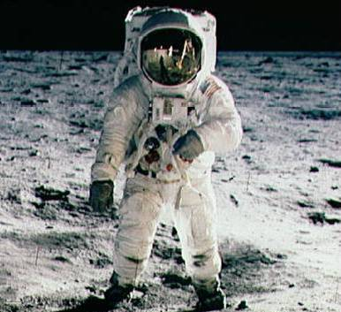
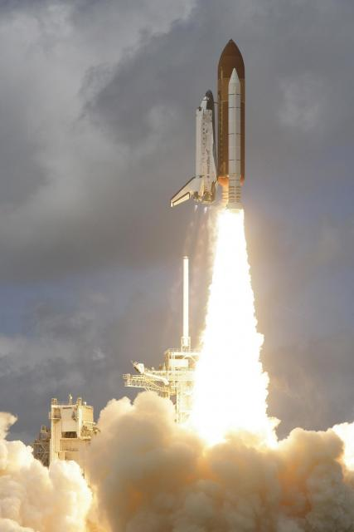
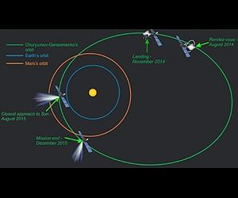
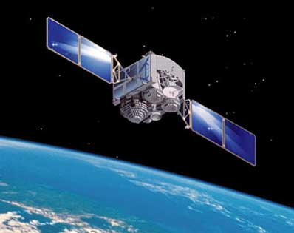
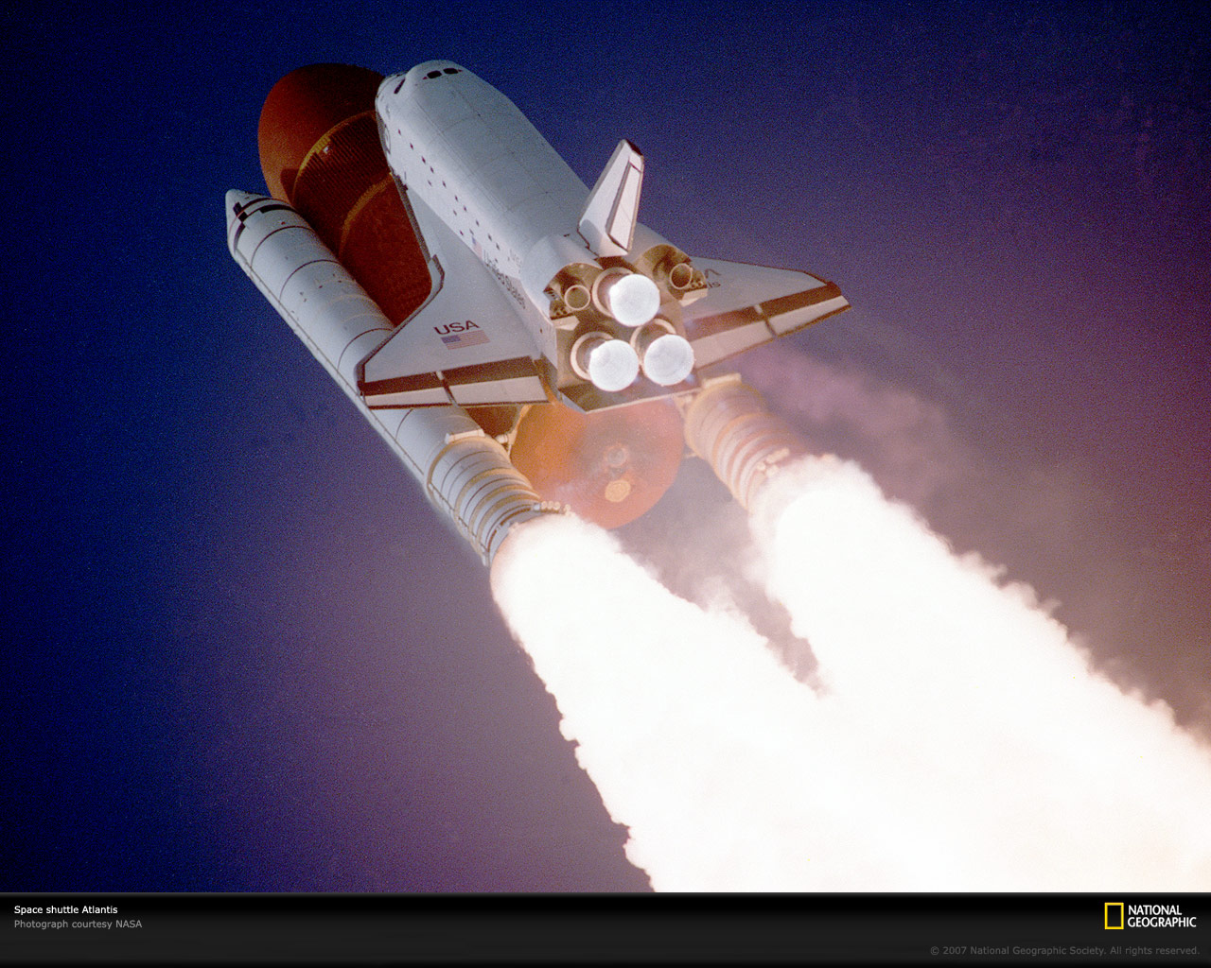
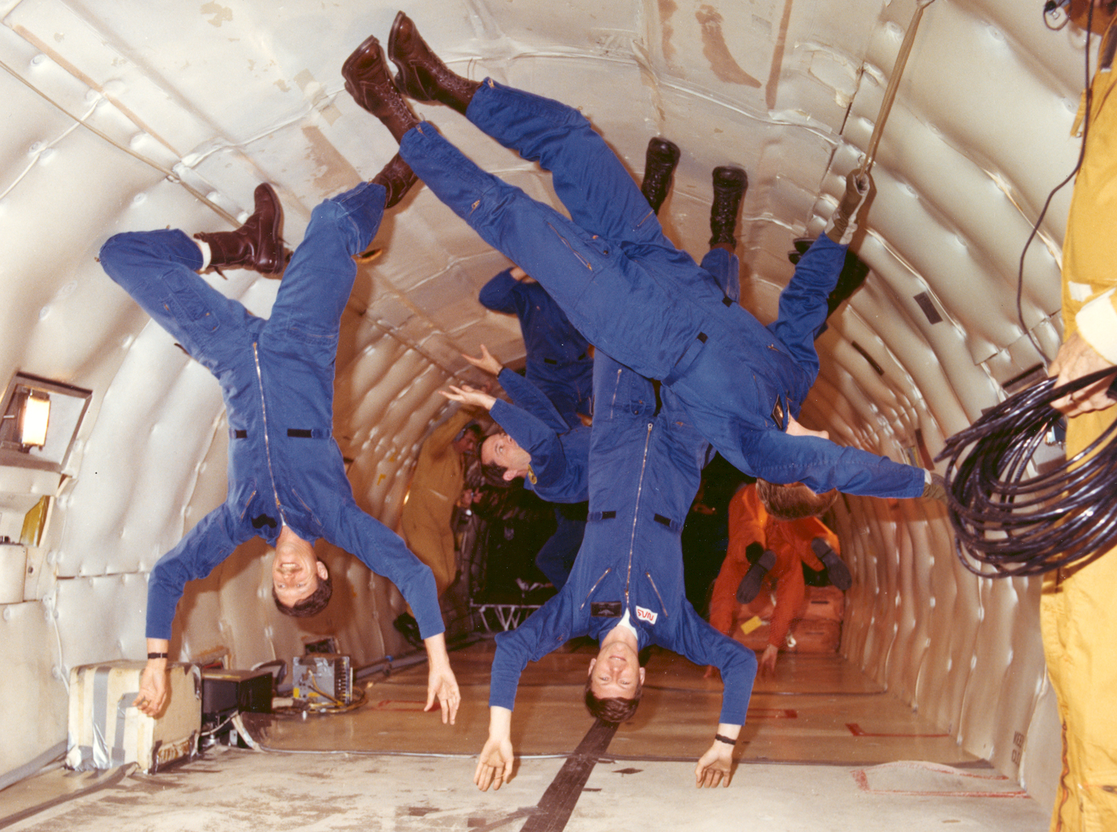
Vocabulary
Astronaut: a person trained to participate in the flight of a spacecraft
Launches: puts into action by force
Mission: an operation that is assigned to achieve certain goals.
Orbit: the path of a spacecraft around the earth
Reusable: able to be used again
Satellite: a device made to orbit the earth while performing a task
Space shuttle: a spacecraft launched like a rocket that can return to earth and land like a plane
Specialist: one who becomes an expert in a particular field
Weightlessness: the condition of being without weight.

Slide 4
We will fill in vocabulary words where they best fit the context
Is your dream to become an and fly to distant worlds in outer space?
Do you wonder what it would be like to feel the ?
Do you imagine yourself in , circling the earth in a ?
Do you get up at 4 a.m. to watch the take off on a and learn more about space?
Are you hoping to become a in space science?
Do you choose foods that come in containers because you know that trash is a big problem in space?
Are you jealous when NASA a new space probe, and you are not one of the scientists controlling it?
Astronaut
Launches
Mission
Orbit
Reusable
Satellite
Space shuttle
Specialist
Weightlessness
Back to Day 1 Schedule

Slide 5
Main Idea: We will identify main ideas in paragraphs.
Activate Prior Knowledge
Concept
What was the selection “Volcanoes” about?
The topic of the selection was volcanoes.
Each paragraph had a main idea that was focused on.
Topic: the subject most or all of the paragraphs tell about.
Main idea: the main point a paragraph or a section makes about the topic.
Details: supporting information about the main idea

Slide 6
Skill: We will identify main ideas.
Look at the second paragraph on page 213.
Mae loved to work on school science projects. She spent many hours at the public library, reading books about science and space. On summer nights, she liked to lie outside, look up at the stars, and dream of traveling in space. Mae was fascinated by the real-life space flights and moon landings that she watched on television. Mae Jemison knew that she wanted to be an astronaut. Although all the astronauts at that time were white and male, Mae wasn’t discouraged.
The main idea is not directly stated. By thinking about the details: she loved working on science projects, read books about science and space, liked stargazing, and dreamed of becoming an astronaut, I can infer a main idea:
As a child, Mae Jemison was fascinated with science.
Read the paragraph.
Is the main idea stated?
If it is not, look at the details to determine what the paragraph was about.

Slide 7
Skill: We will identify main ideas.
We do:
Read pages 213-214
What is the main idea of these pages?
What details support this main idea?
You do
Read pages 215-216
What is the main idea of these pages?
What details support this main idea?
Read the paragraph.
Is the main idea stated?
If it is not, look at the details to determine what the paragraph was about.

Slide 8
We will identify main ideas.
Closure
Practice
What is a topic?
What is a main idea?
If the main idea is not stated, how do we identify the main idea?
Guided practice
As we read, we will continue filling in the chart on practice book pg. 114
Independent practice
Later in the week we will complete practice book pages 116-117
Back to Day 1 Schedule

Slide 9
Daily Language Practice: We will proofread and correct sentences with spelling and grammar errors.
Yesterday the school turm end.
Can you help stirr the cake batter
Last night we watch the parrot fly to its new purch.
Back to Day 1 Schedule

Slide 10
Day 2 Schedule
Reading
Segment 2 (216-222)
Main Idea
Practice book pg. 114
Comprehension questions (224)
Practice book pg. 115
Vocabulary
Practice book pg. 113
Word Work
Suffixes –ive and –ic
Spelling
Practice book pg. 119
Writing and Language
Daily Language Practice
Grammar
Practice book pg. 123
Back to Mae Jemison

Slide 11
Suffixes –ive and –ic We will identify the meaning of words with the suffixes –ive and –ic.
Activate Prior Knowledge
Concept
Where do suffixes belong on a base word?
What does the suffix -ous mean?
Today, we will work with words containing the suffixes –ive and -ic.
-ive: pertaining to, or having the characteristics of
Massive: having mass
-ic: pertaining to, or having the characteristics of
Artistic: pertaining to art

Slide 12
Skill
I do:
historic
pertaining to history
Inventive
characteristics of inventing
We do:
periodic
positive
You do:
realistic
supportive
Circle the suffix.
Underline the base word.
Define the base word.
Put the meaning of the suffix and the base word together to define the whole word.
Notes:
We do: have students partner talk and then show each step on their whiteboards…call on non-volunteers to share each step (change your pointer to pen to circle, underline, and write definitions)
You do: on whiteboards (change your pointer to a pen to circle, underline, and write definitions)

Slide 13
Closure
What do the suffixes –ive and –ic mean?
What is the meaning of majestic?
Having the characteristics of majesty.
In the direction of majesty.
Independent practice
Practice book pg. 118
Back to Day 2 Schedule

Slide 14
Daily Language Practice: We will proofread and correct sentences containing spelling and grammar errors.
It was hard for max to stere the sled down the steep hill.
Mr. rivera asked us to check the reer door.
Back to Day 2 Schedule

Slide 15
Day 3 Schedule
Reading
Partner Read
Main Idea
Practice book pg. 116-117
Word Work
Latin Root vis
Spelling
Practice book pg. 120
Writing and Language
Daily Language Practice
Back to Mae Jemison

Slide 16
Latin Root: vis We will analyze the meaning of words containing the Latin root vis.
Activate Prior Knowledge
Concept
Juan’s vision was blurry, so he could not see the board.
What does the word vision mean?
Vis: a Latin root meaning “to see”
Example:
Juan’s vision was blurry, so he could not see the board.
Vision means “ ability to see”
Importance:
Recognizing word roots can help you figure out the meaning of words you do not recognize.

Slide 17
Latin Root: vis We will analyze the meaning of words containing the Latin root vis.
Skill
Guided Practice
Highlight the word root
Look at the prefix and suffix
What do they mean?
Use context clues to help define the word.
I do
The students made a visual representation of the pyramids.
We do
We will visit the Museum of Natural History next week.
You do
When you read a story, it helps to visualize the characters.

Slide 18
Latin Root: vis We will analyze the meaning of words containing the Latin root vis.
Closure:
What does vis mean?
How do you determine the meaning of a word containing this root?
What do word means to go “see” someone?
visage
visit
Practice:
What other words can you think of containing vis?
What do each of these words mean?
Back to Day 3 Schedule

Slide 19
Daily Language Practice: We will proofread and correct sentences with spelling and grammar errors.
Look at Matt and Amy grabs those birnt marshmallows.
Did you mean to smere the paint in this picture
Ms. Washington will tells us when to retoorn the books.
Back to Day 3 Schedule

Slide 20
Day 4 Schedule
Reading
Using Text Organization
“Into the Deep” (226-229)
Word Work
Spelling
Practice book pg. 121
Dictionary: Syllables (229i)
Practice book pg. 122
Writing and Language
Daily Language Practice
Grammar
Practice book pg. 124
Back to Mae Jemison

Slide 21
Text Features: We will use text features to identify important information.
Concept
Importance
Nonfiction: writing that is true and factual.
Headings: identify the topic or main point covered in each section of an article
Example: “What’s Down There?” (pg. 227)
Captions: description of the pictures in an article.
Example: “Deep Flight I, able to dive to 3,300 ft. 14 ft. long” (pg. 227)
Using the text features will help you to understand the facts and ideas presented in a nonfiction piece of writing.

Slide 22
Skill
We do:
Open your textbook to page 226.
Skim pages 226, 227 for the headings
What will each section be about?
Read page 226
What are the main ideas presented in each paragraph?
What are the photographs showing?
Read the headings
Look for new paragraphs ~ what is the main idea in each paragraph?
Read the captions

Slide 23
Skill
You do:
Turn to pages 228, 229.
Skim the pages for the headings
What will each section be about?
Read page 228
What are the main ideas presented in each paragraph?
What are the photographs showing?
Read the headings
Look for new paragraphs ~ what is the main idea in each paragraph?
Read the captions

Slide 24
Closure
What do you use the headings for?
What do the paragraphs tell us?
What do the captions tell us?
Under which heading might you find information about the ocean floor?
A Costly Quest
The Very, Very Bottom
Back to Day 4 Schedule

Slide 25
Daily Language Practice: We will proofread and correct sentences with spelling and grammar errors.
In florida I saw an exhibit about how a perl is made.
Jason think this baseball card is werth two dollars.
Back to Day 4 Schedule

Slide 26
Day 5 Schedule
Reading
Comprehension Test
Vocabulary Test
Word Work
Spelling Test
Writing and Language
Practice book pg. 125
Back to Mae Jemison

