Slide 1
R2.5- Restate facts and details
2nd grade

Slide 2
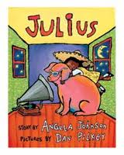
Today we will distinguish¹ between fantasy and realism in the story, Julius.
distinguish¹ means to choose between

Slide 3
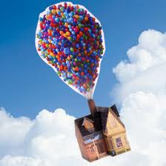
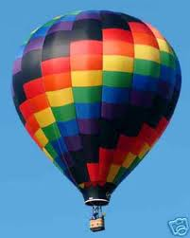
Look at the two pictures. Which pictures shows something that is make-believe? Talk to your partner and write it on your white board.
A.
B.

Slide 4
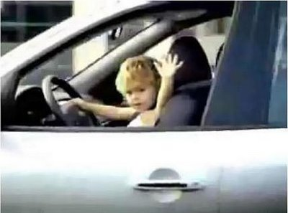
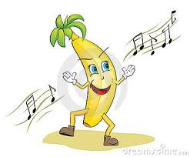
Fantasy is when something could not happen in real life.
Characters
Events
A dancing banana
A baby is driving a car

Slide 5
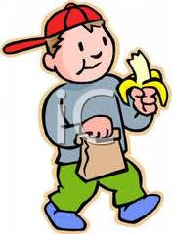
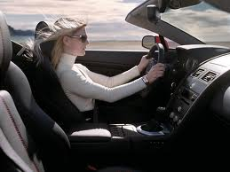
Realism is when something could happen in real life.
A boy eating a banana
A lady driving a car

Slide 6
When something could not happen in real life it is called _________.
When something could happen in real life it is called _________.

Slide 7
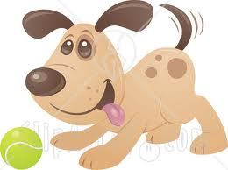
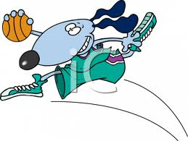
Which shows something that is fantasy?
A.)
B.)
A dog playing with a tennis ball
A dog playing basketball
I know ______ shows fantasy because ________________.

Slide 8
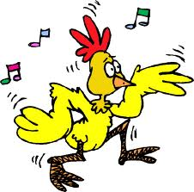
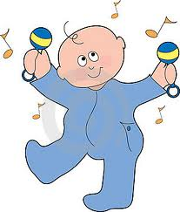
Which shows something that is realism?
A.)
B.)
A dancing chicken
A dancing baby
I know ______ shows realism because ________________.

Slide 9
Why is this important?
It will help us to understand what we read.
It can help us to make better choices.
We might see it on a test.

Slide 10
When something could not happen in real life it is called _________.
When something could happen in real life it is called _________.
Julius sits in a chair and reads.
Julius makes a mess.

